Slide 1

THIS COURSE IS ACCREDITED BY

Slide 2
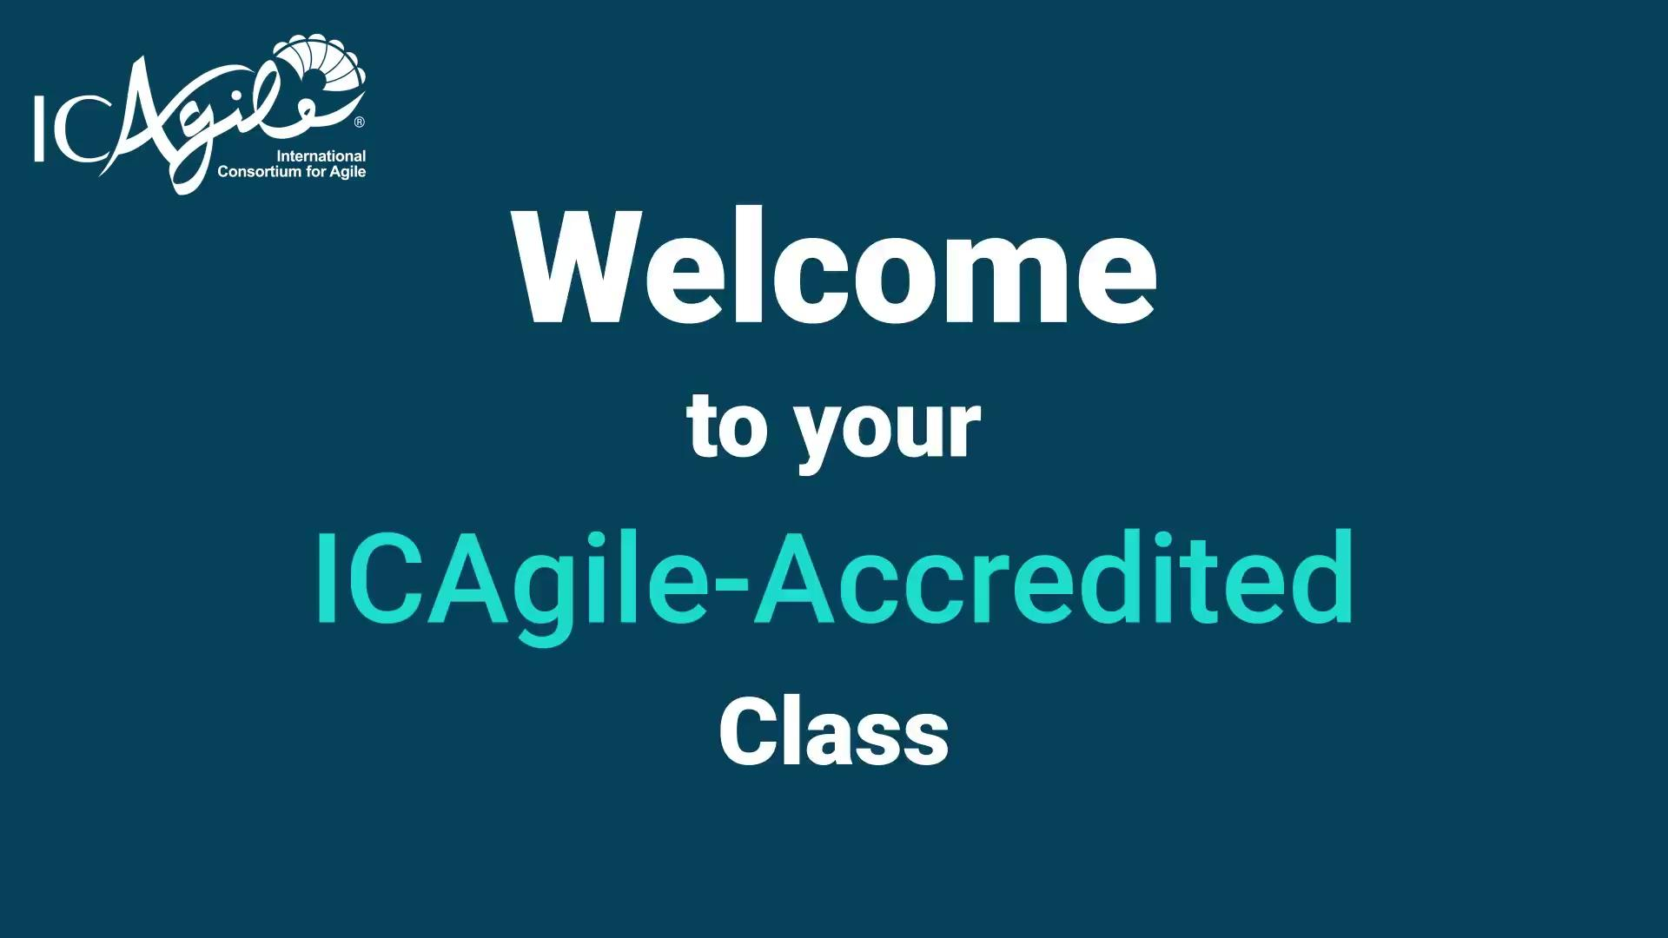
Notes:
Class Introduction Video

Slide 3
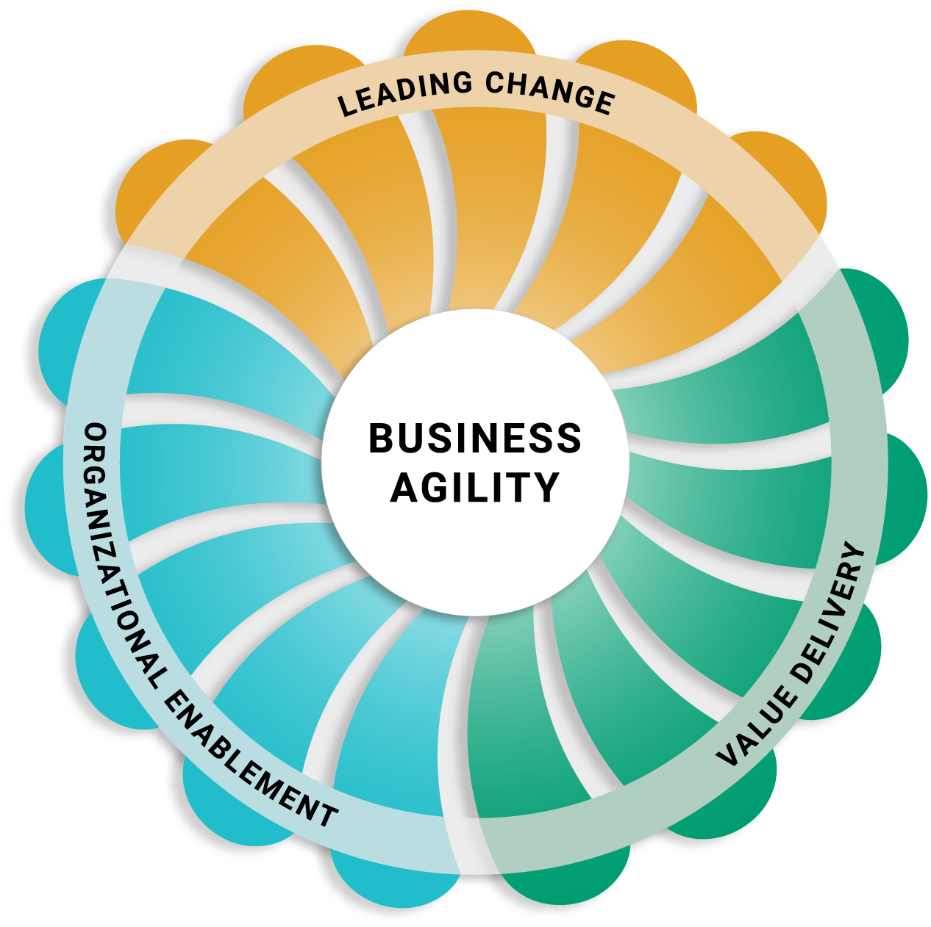
LEADING
CHANGE
Realize sustainable agility through cultural change, not process change.
VALUE
DELIVERY
Delight your target audience with effective high-quality products and customer-centric outcomes.
ORGANIZATIONAL
ENABLEMENT
Build adaptive capability across the organization through dynamic structures and systems.
Notes:
Leading Change
Successful business agility journeys begin with leadership and coaching that catalyzes mindset shifts and unleashes human potential. This Learning Program focuses on the cultural and behavioral changes needed at all levels of the organization to thrive in uncertainty. It also emphasizes the systemic paradigm shifts and ongoing self-development leaders and coaches need to lead organizations through complexity and continuous change.
Value Delivery
Agility is a “must-have” for organizations that seek to deliver value consistently in dynamic environments. This Learning Program encompasses the strategy, technical excellence, product ownership, and delivery management needed to bring highly relevant products to market in today’s fast-moving world.
Organizational Enablement
Essential organizational functions, such as finance and HR, are often seen as impediments to agility. However, with the right shifts in mindset and structure, these functions have the power to enable and amplify agility. This Learning Program covers new ways of working in enabling functions to help accelerate the journey to business agility.

Slide 4
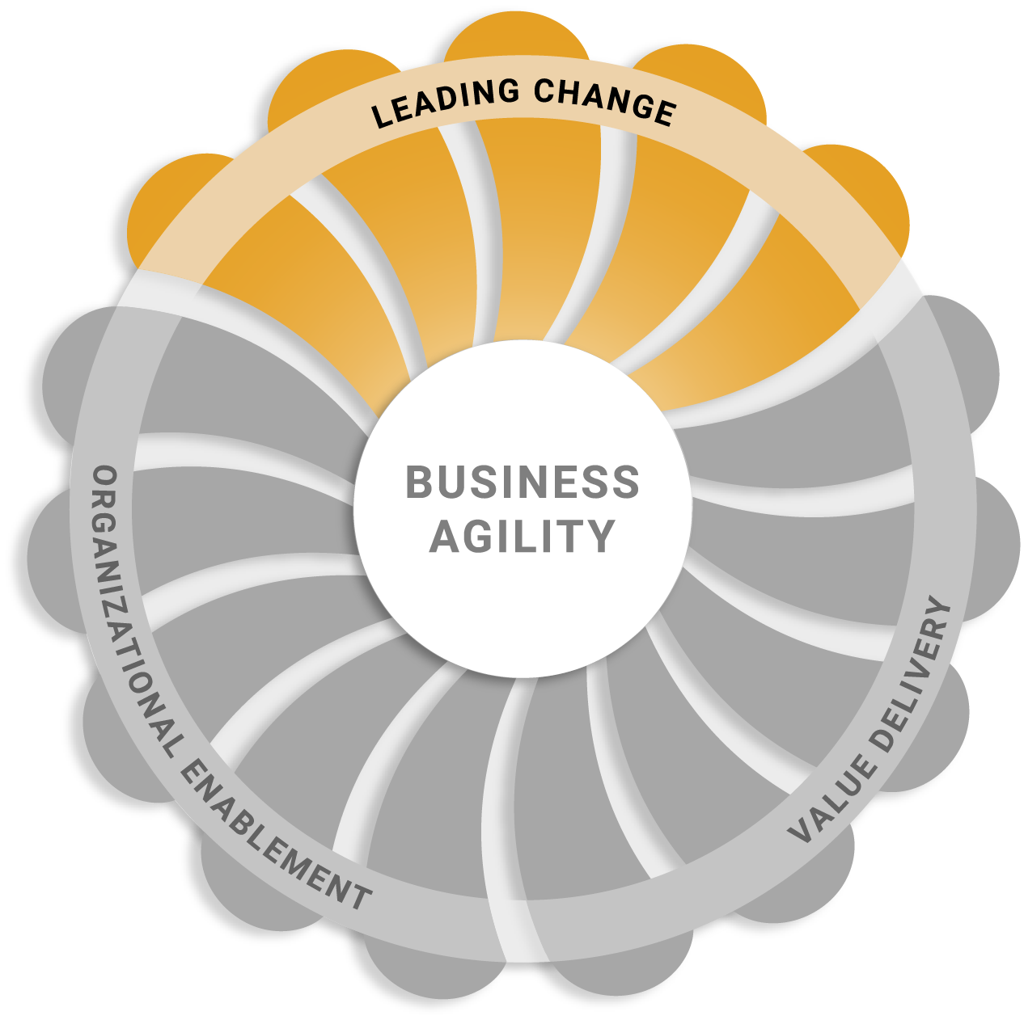
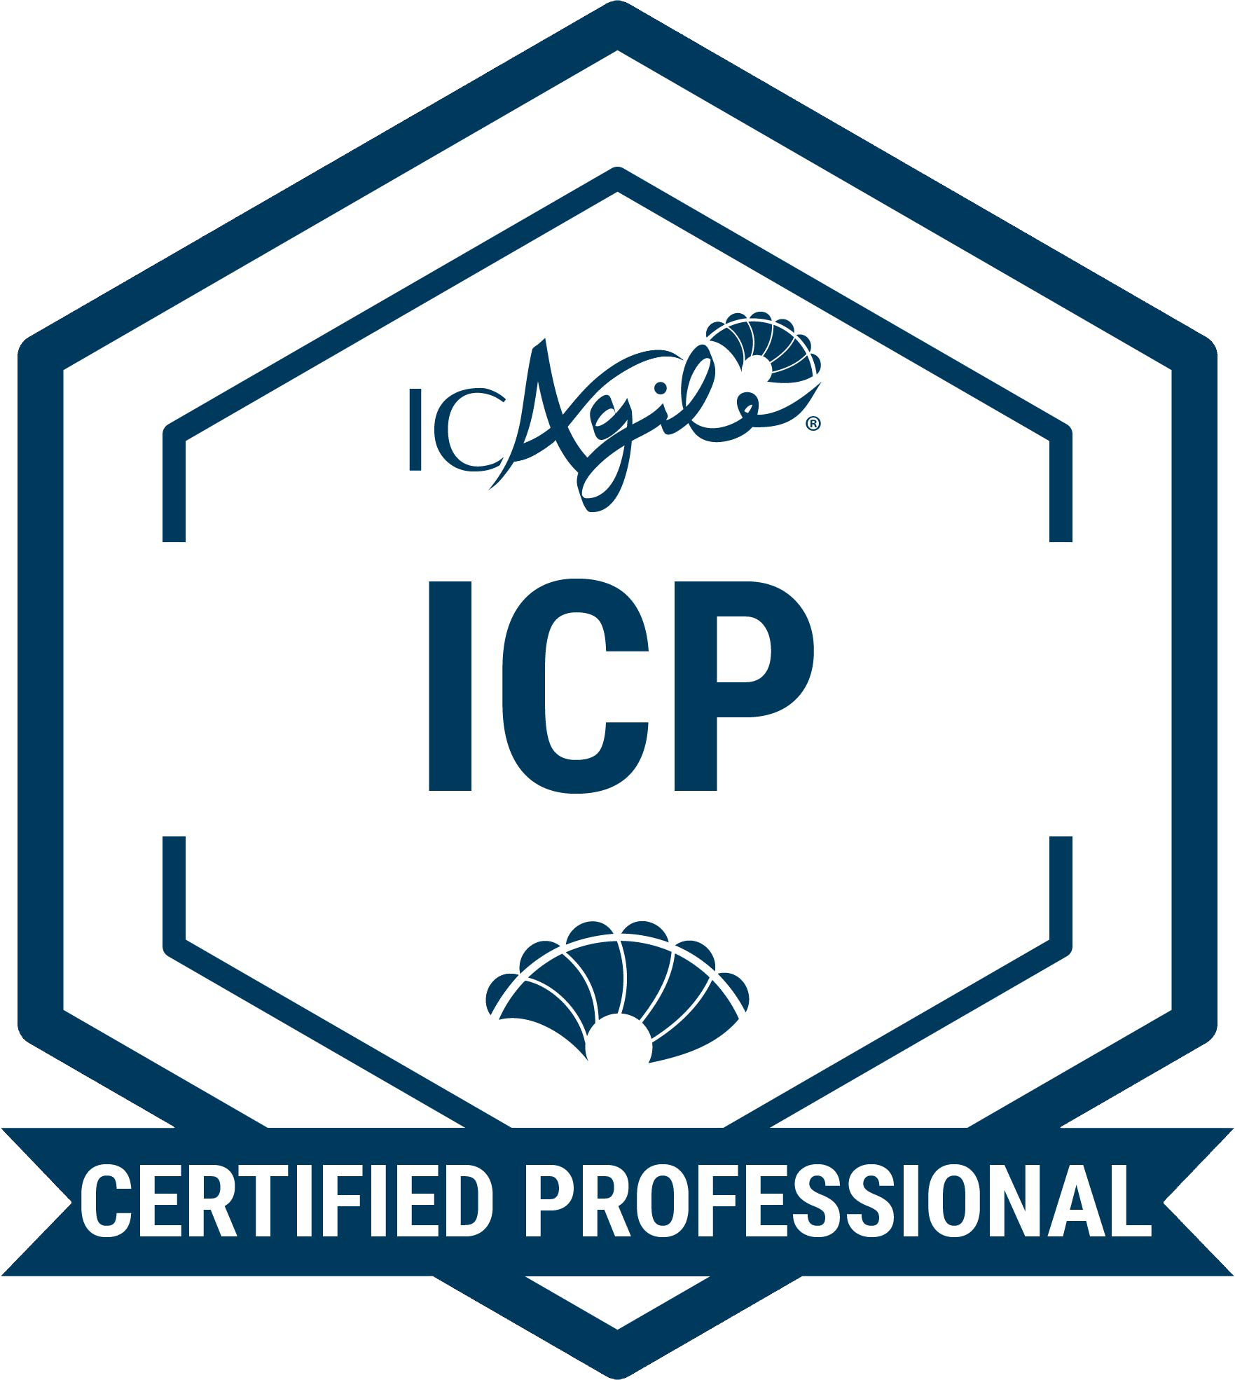
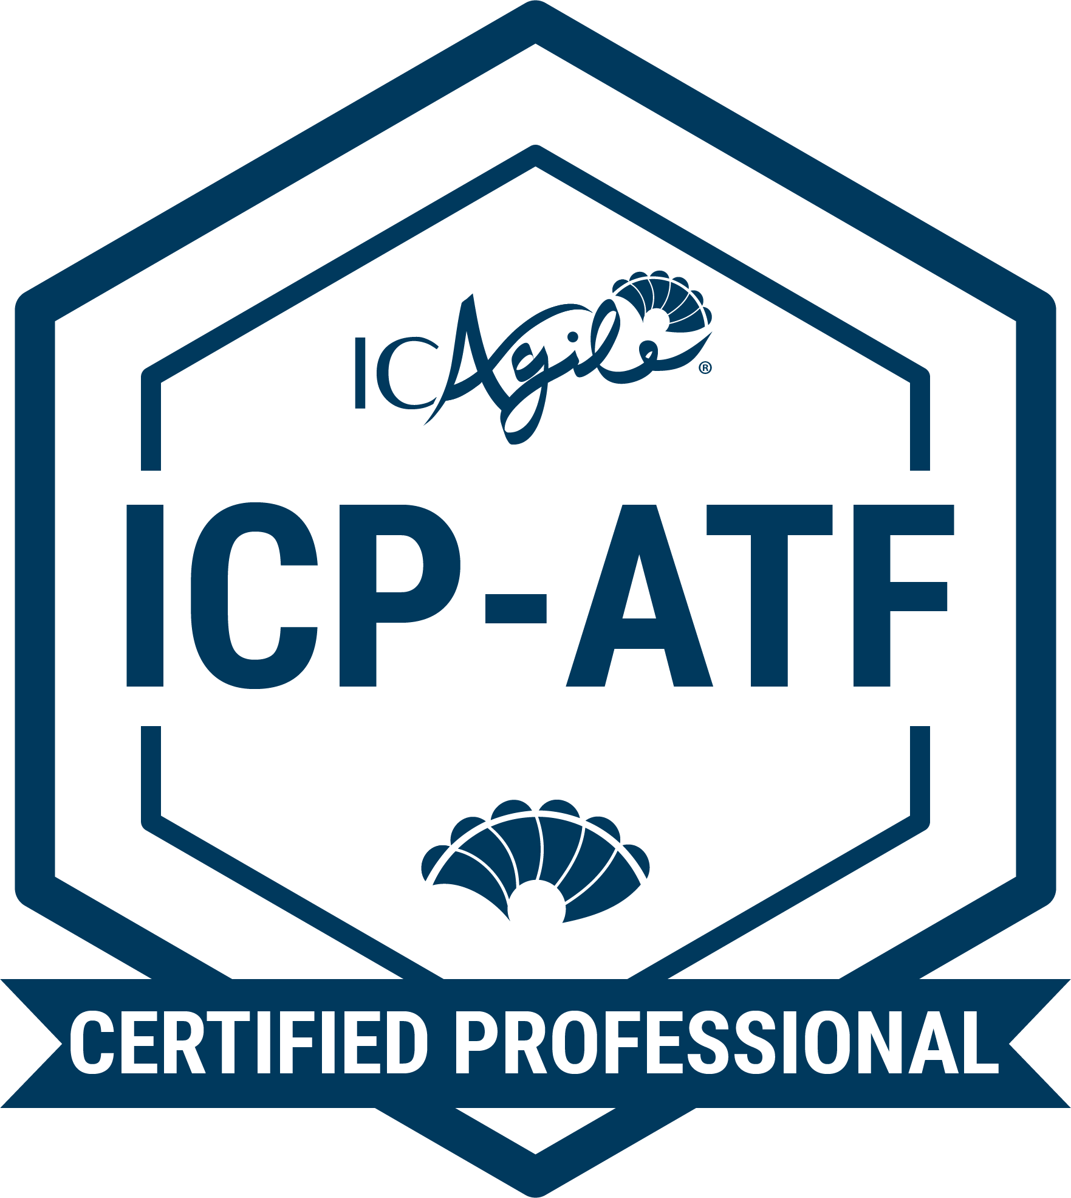
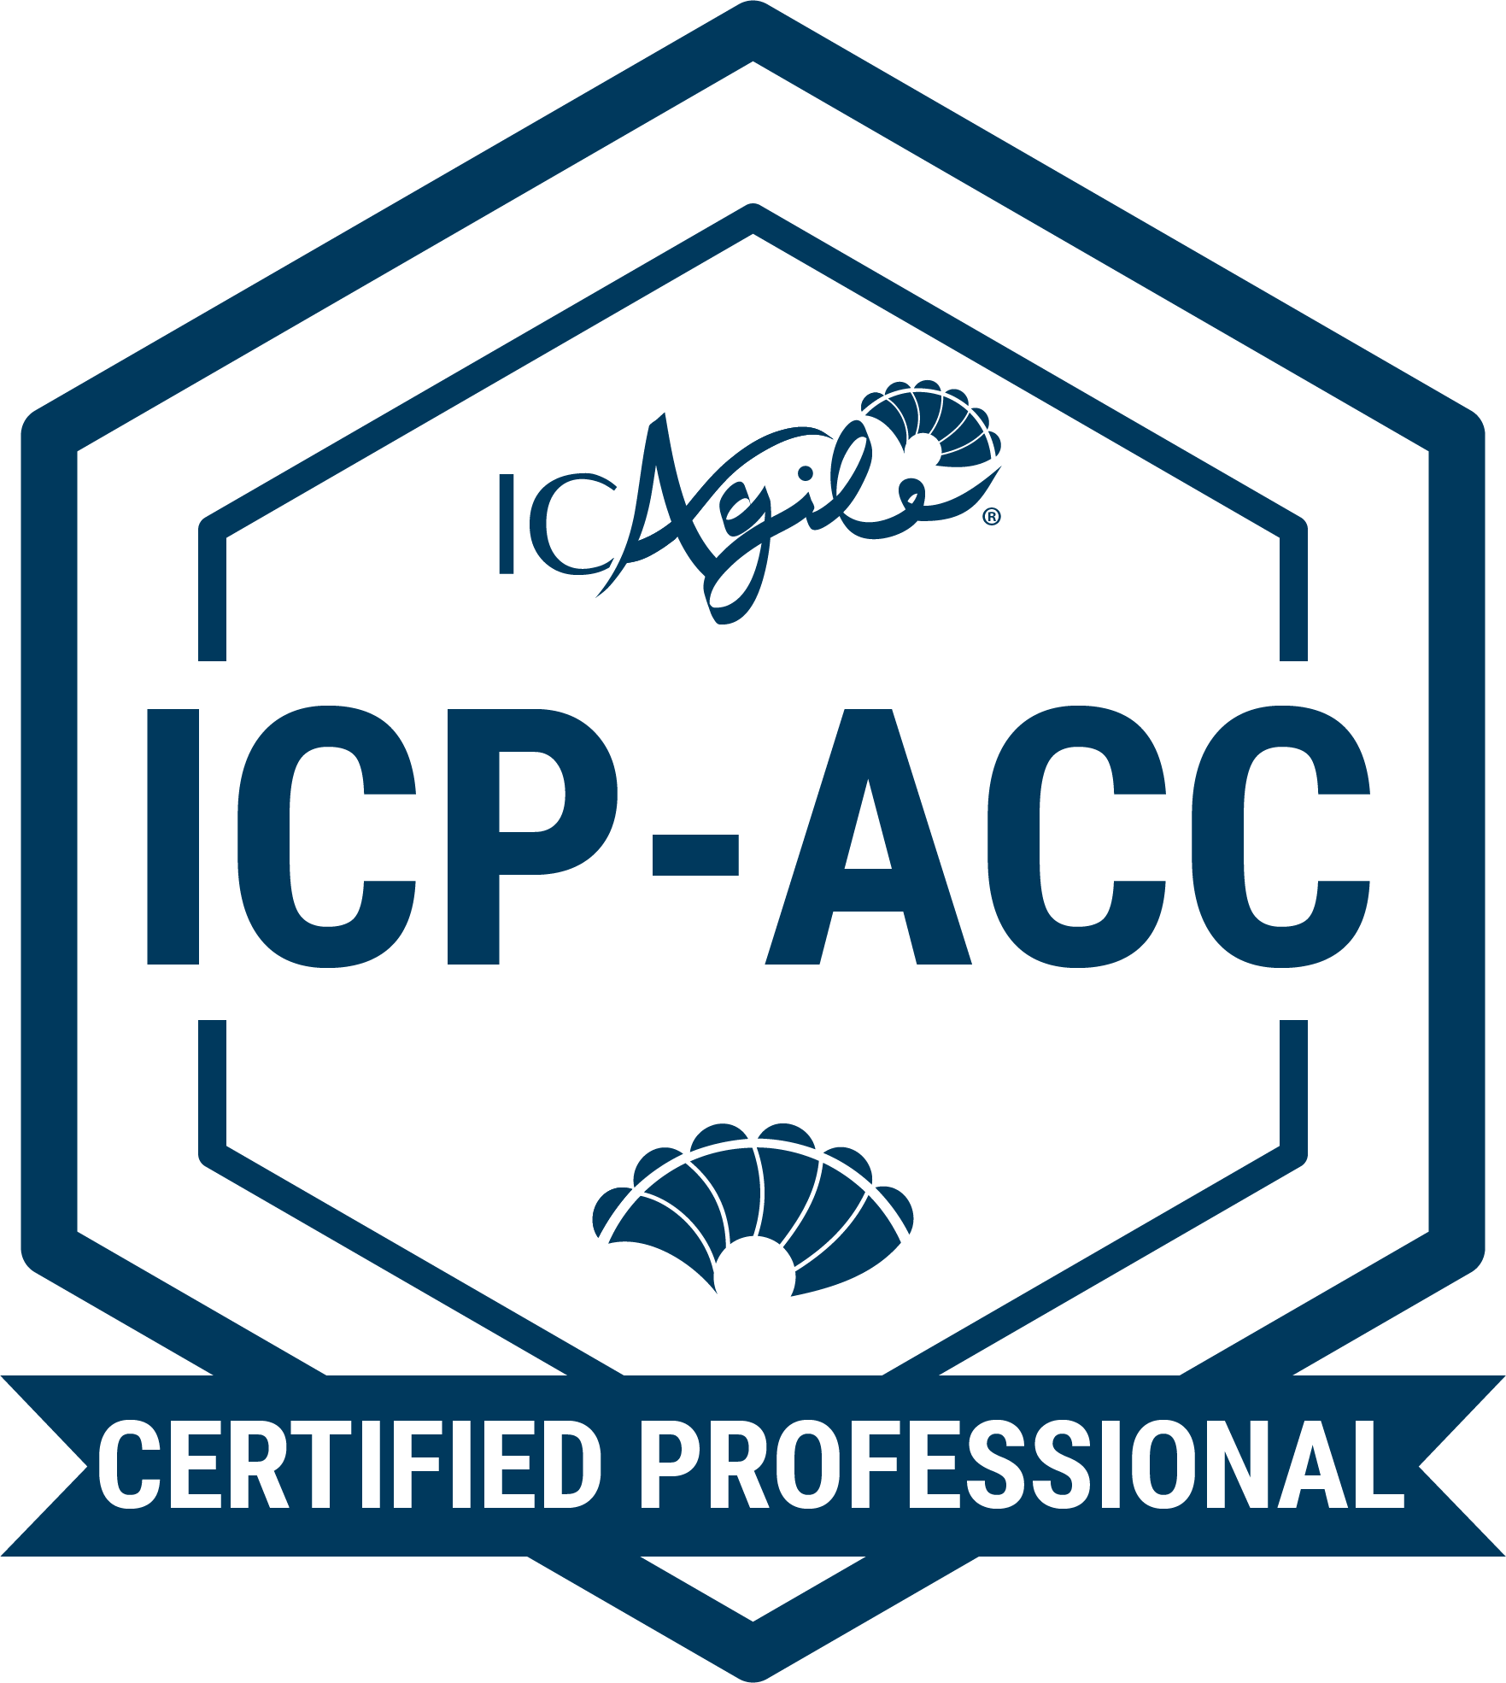
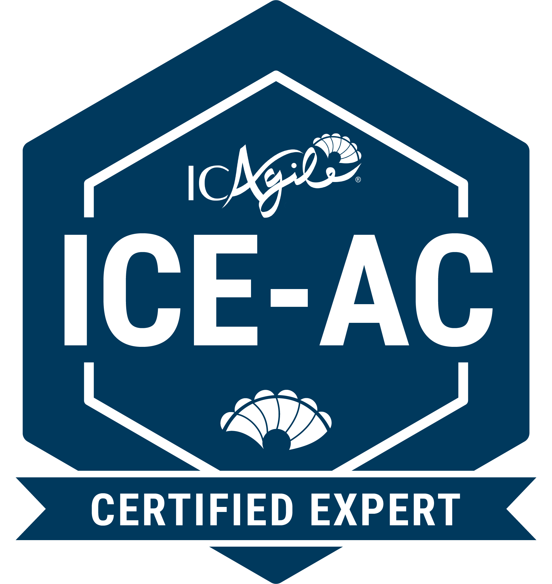
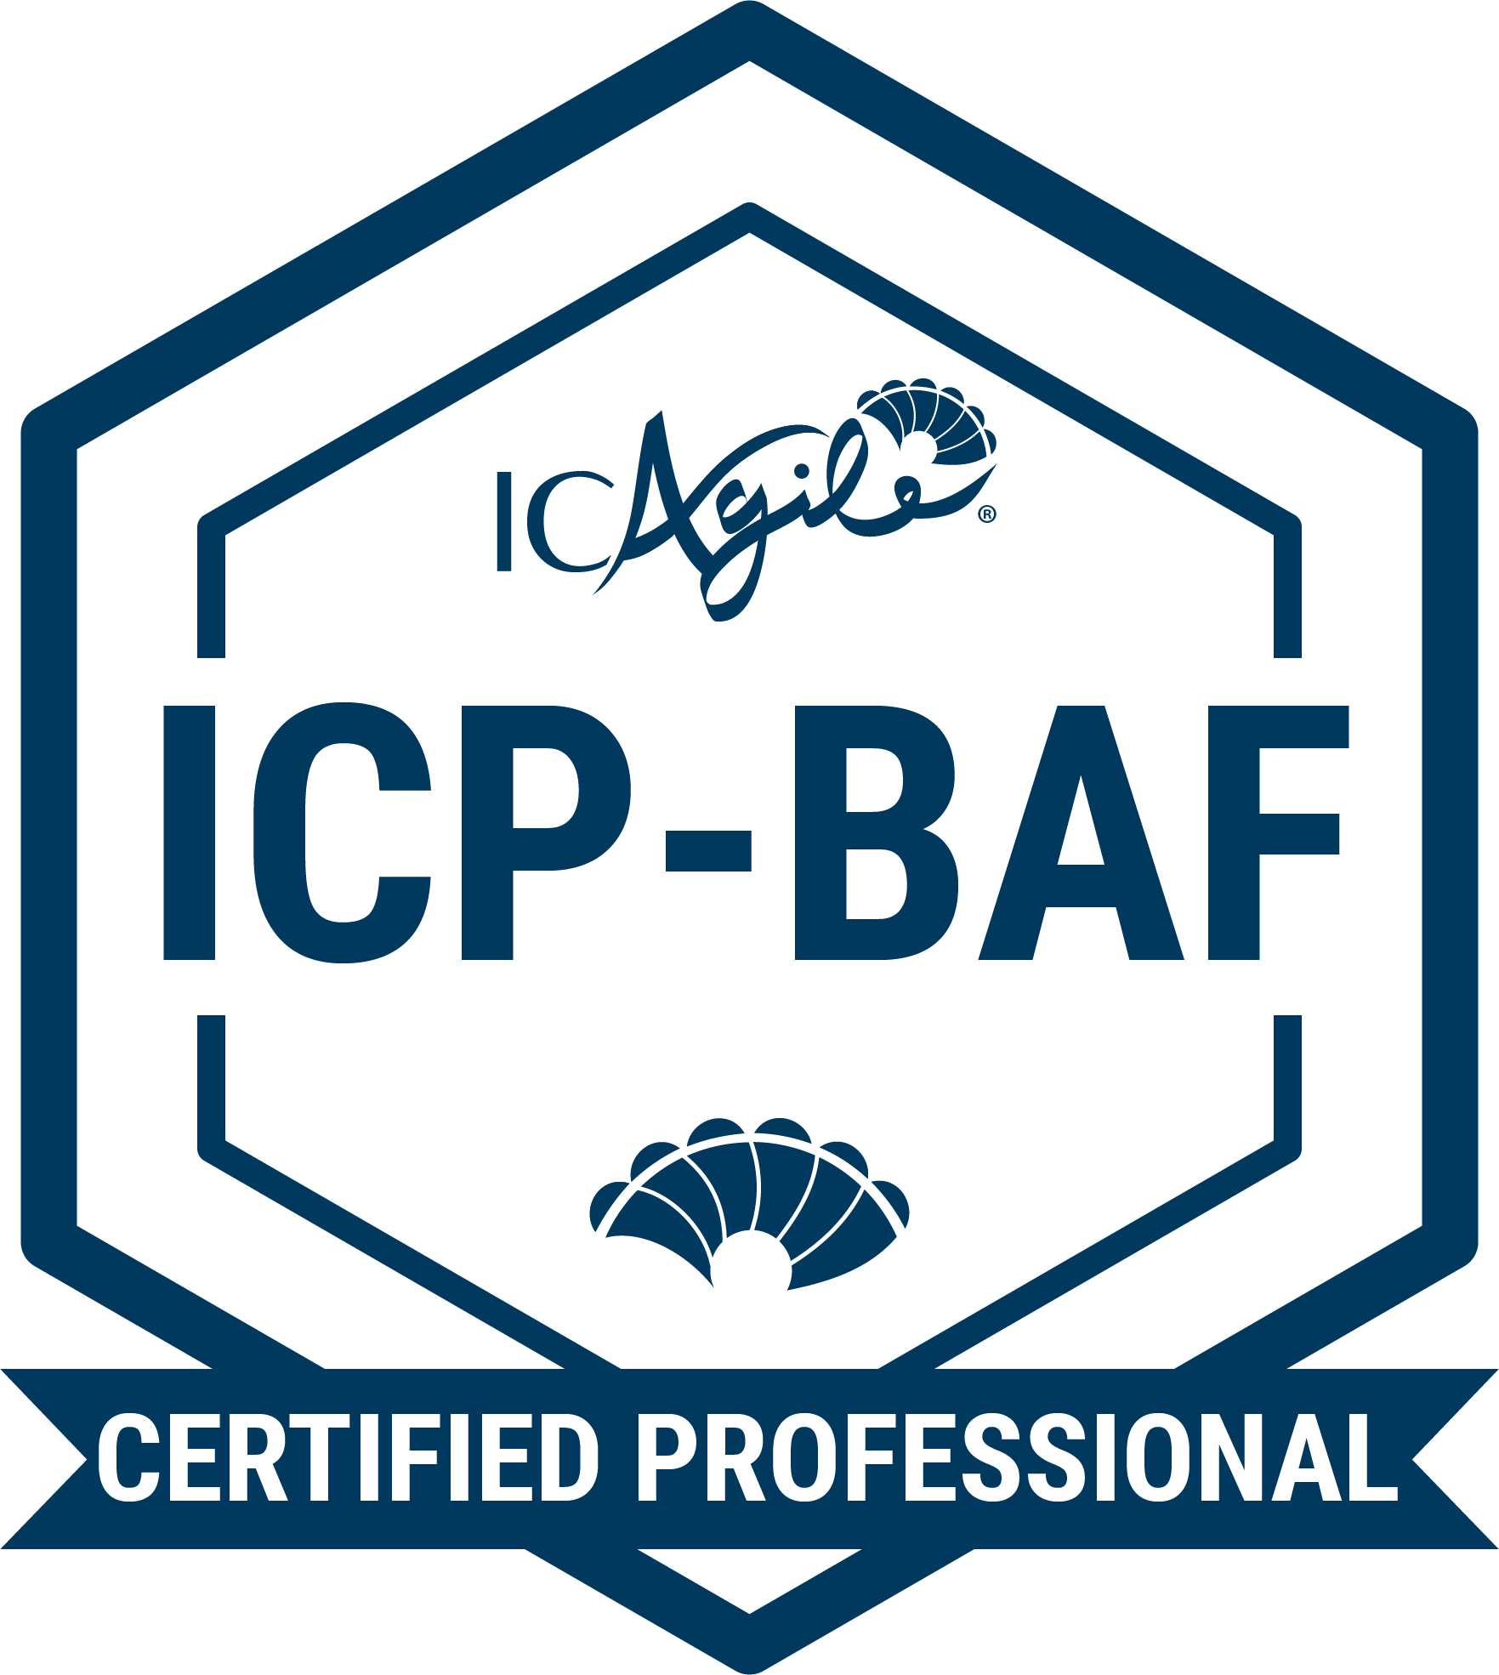
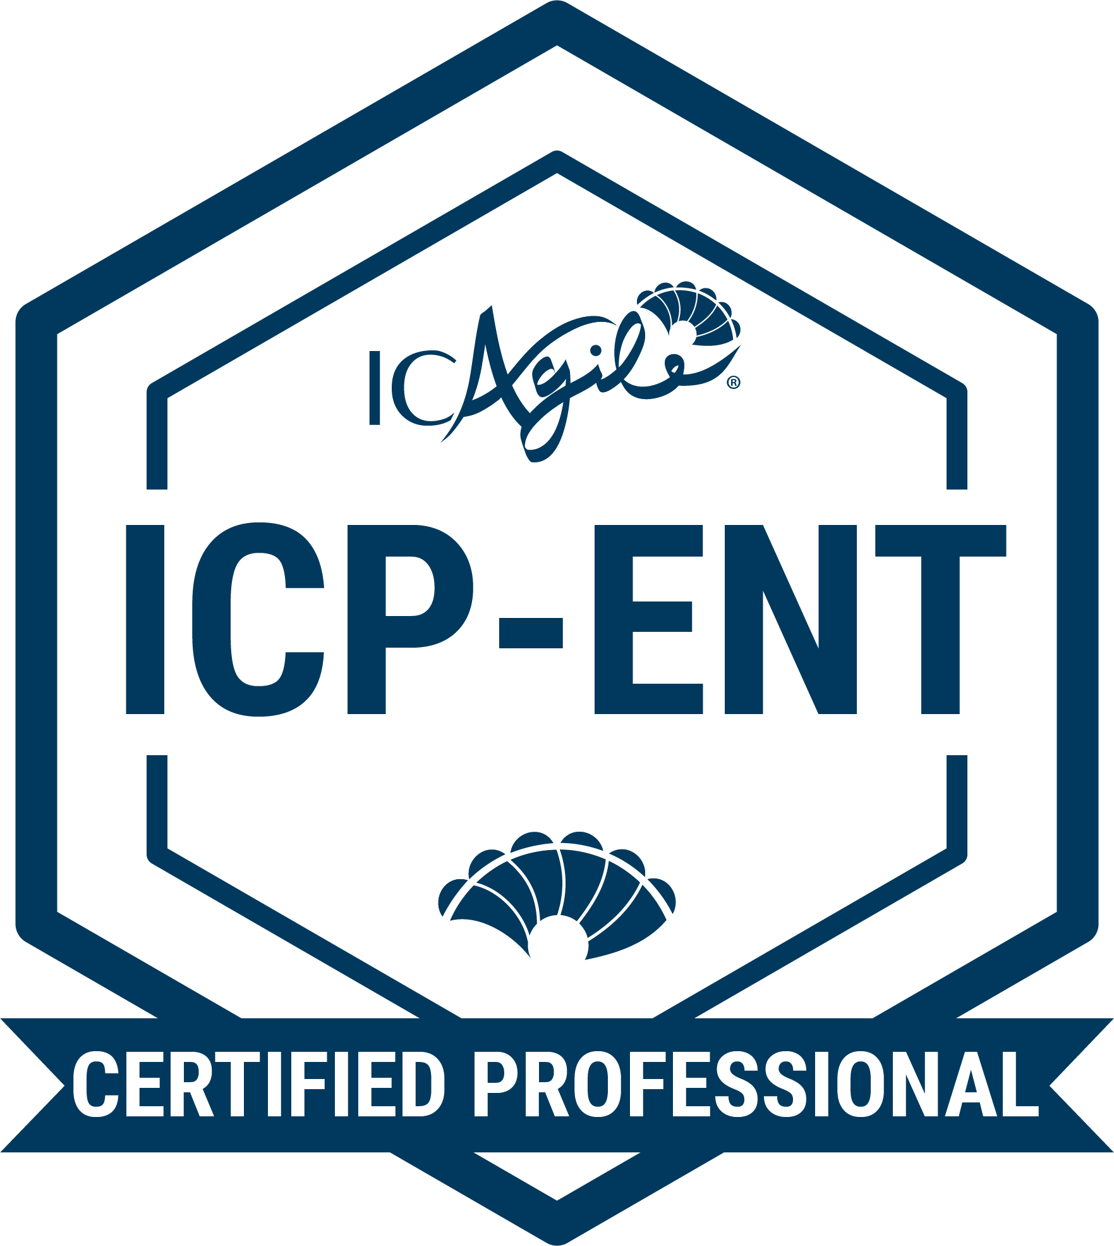
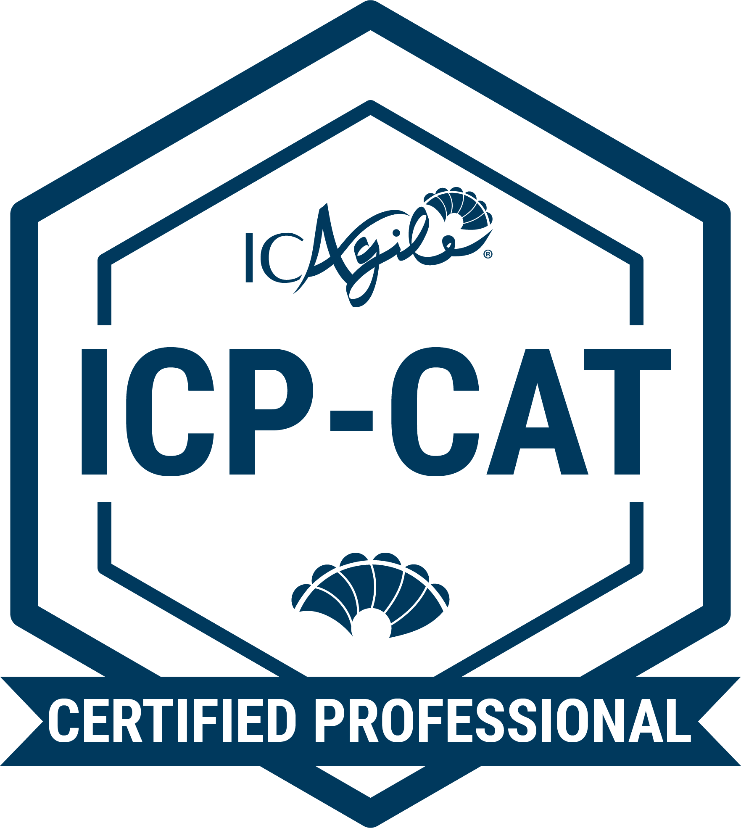
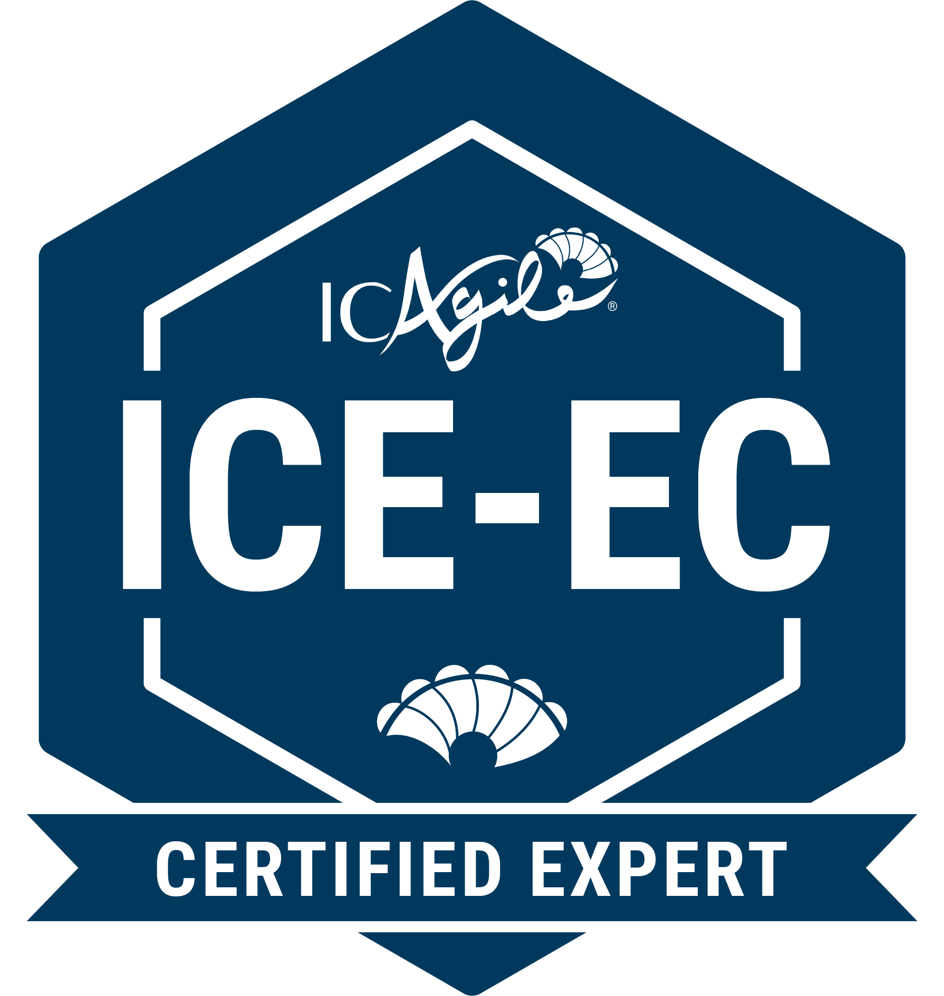
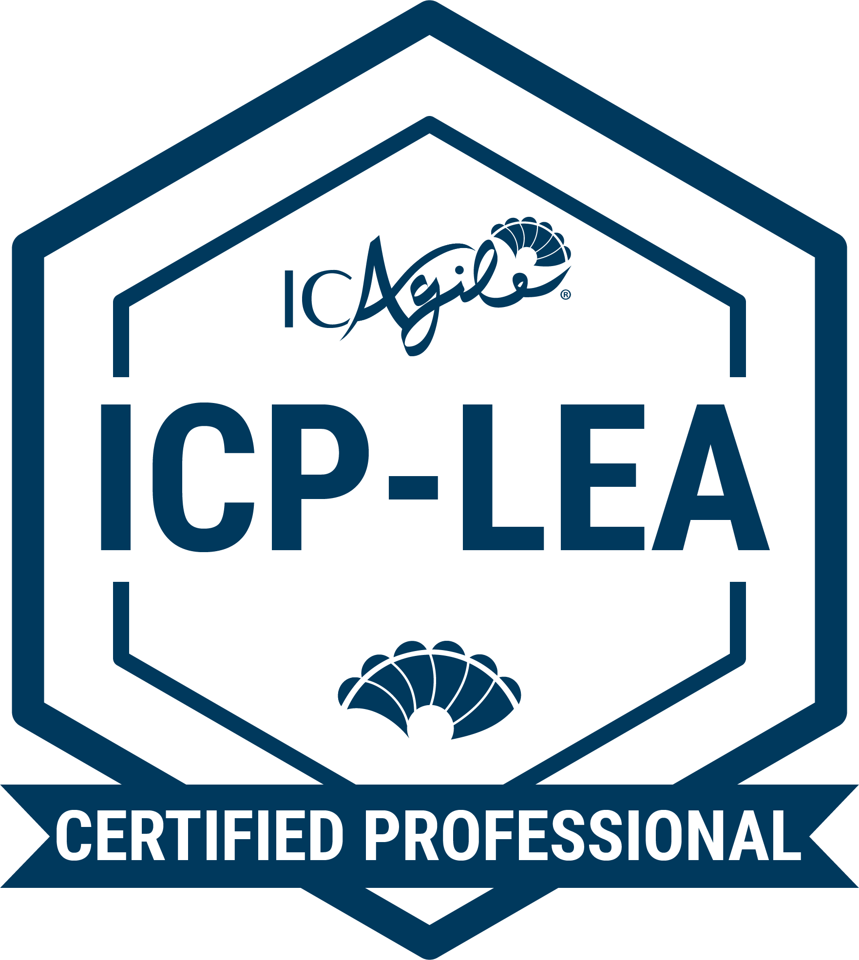
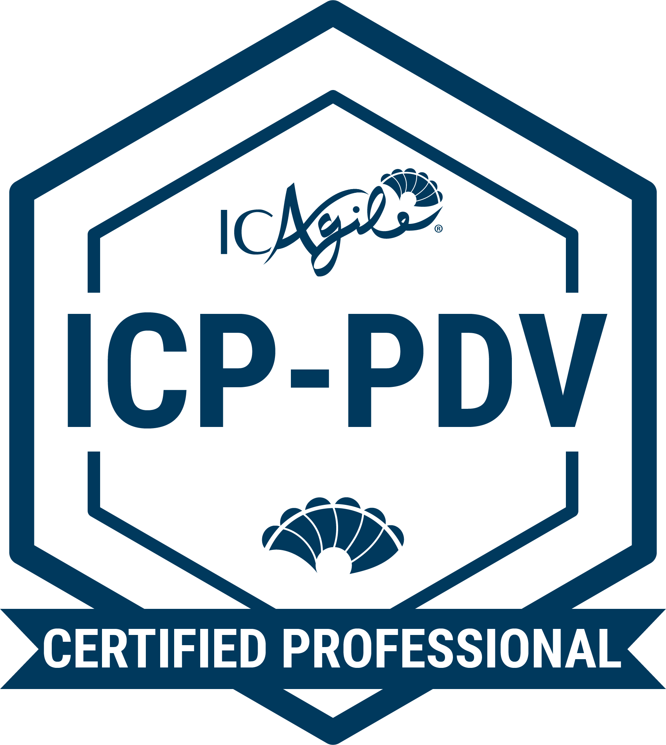
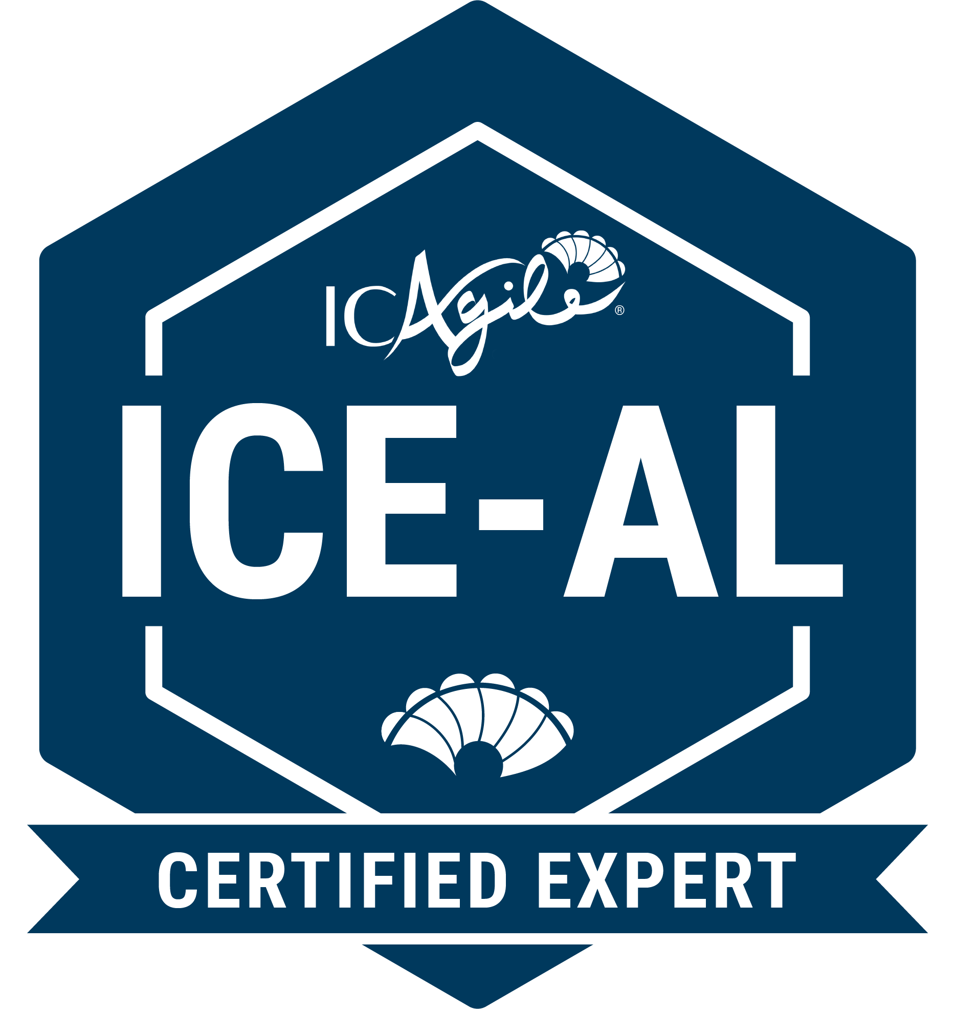
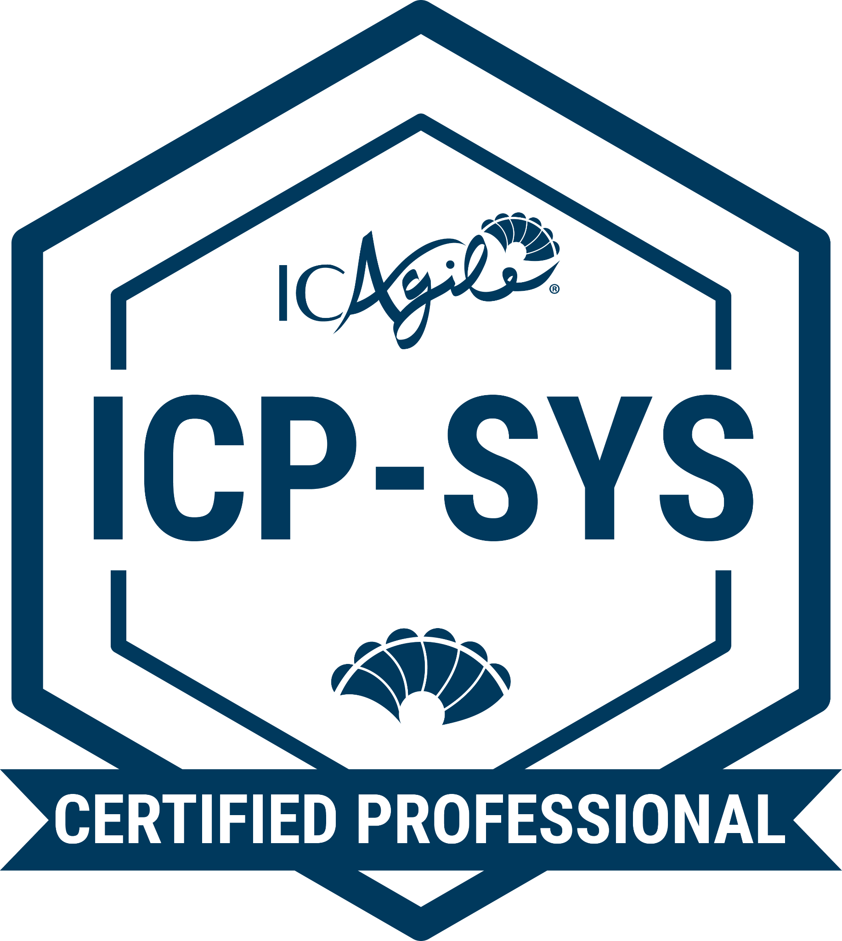
TRACKS IN LEADING CHANGE
Agile Team Coaching
Agile Fundamentals
Agile Team Facilitation
Agile Coaching
Expert in Agile Coaching
Enterprise Coaching
Business Agility Foundations
Agility in the Enterprise
Coaching Agile Transitions
Expert in Enterprise Coaching
Agility in Leadership
Business Agility Foundations
Leading with Agility
People Development
Expert in Agility in Leadership
Additional Recommended Certifications
Systems Coaching
Go Back to Learning Programs

Slide 5
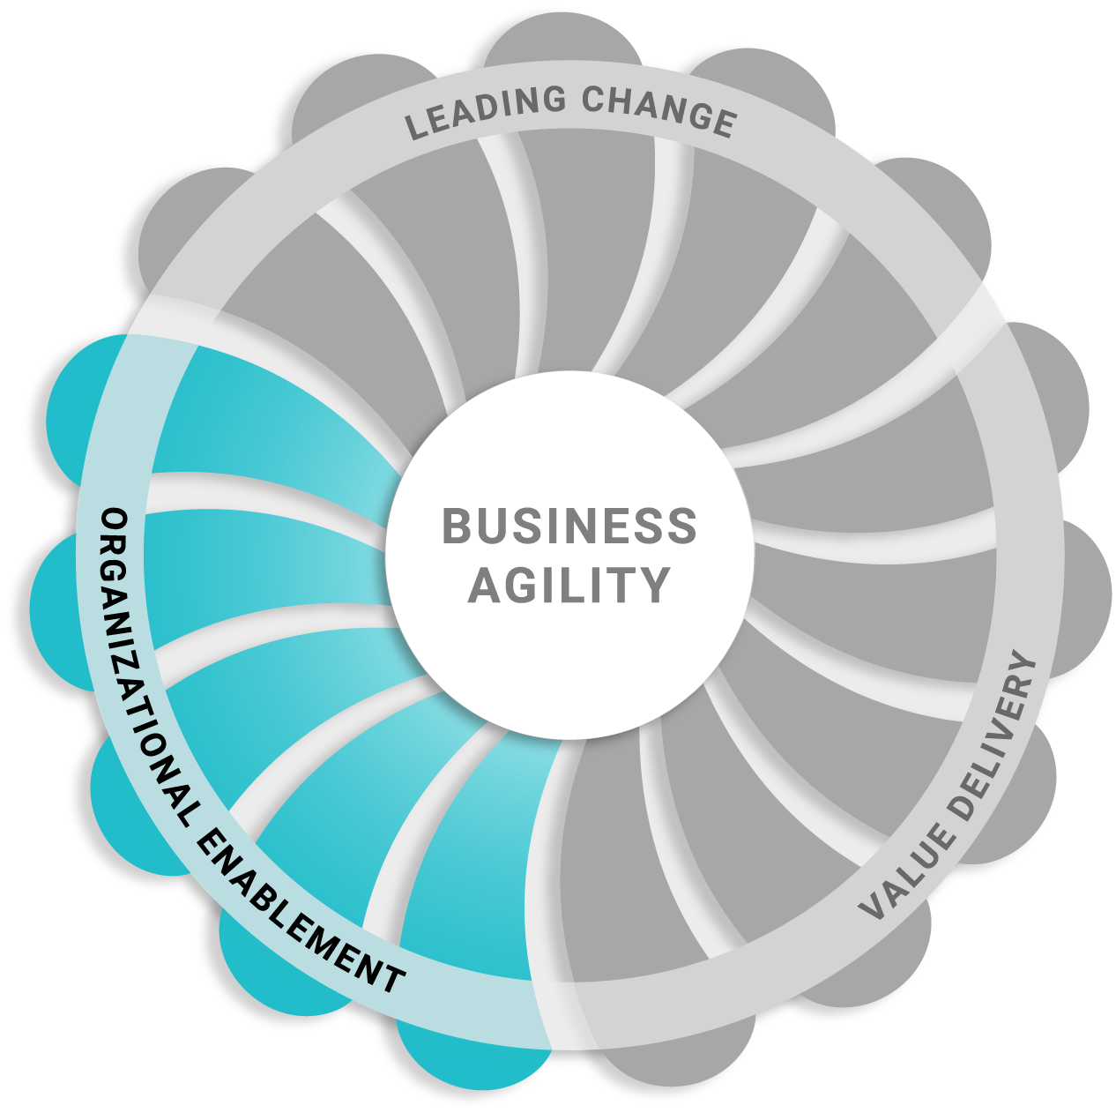
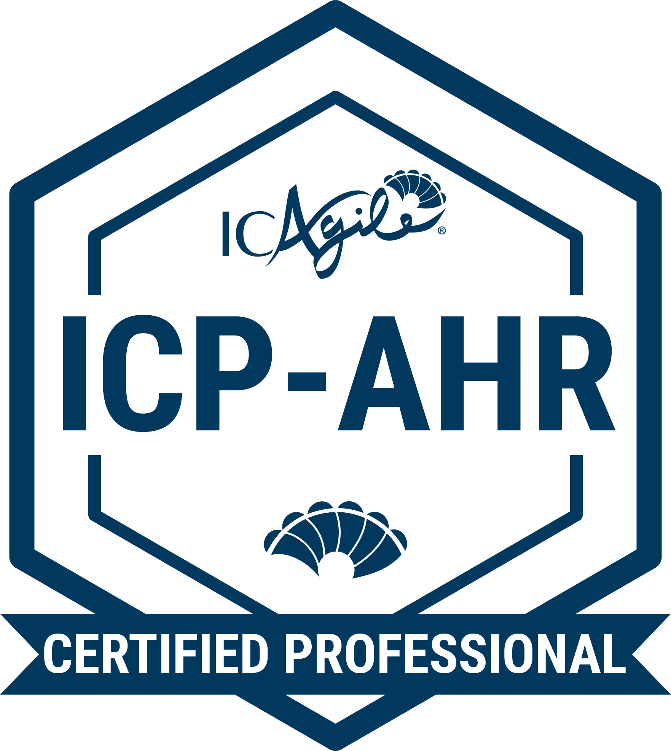
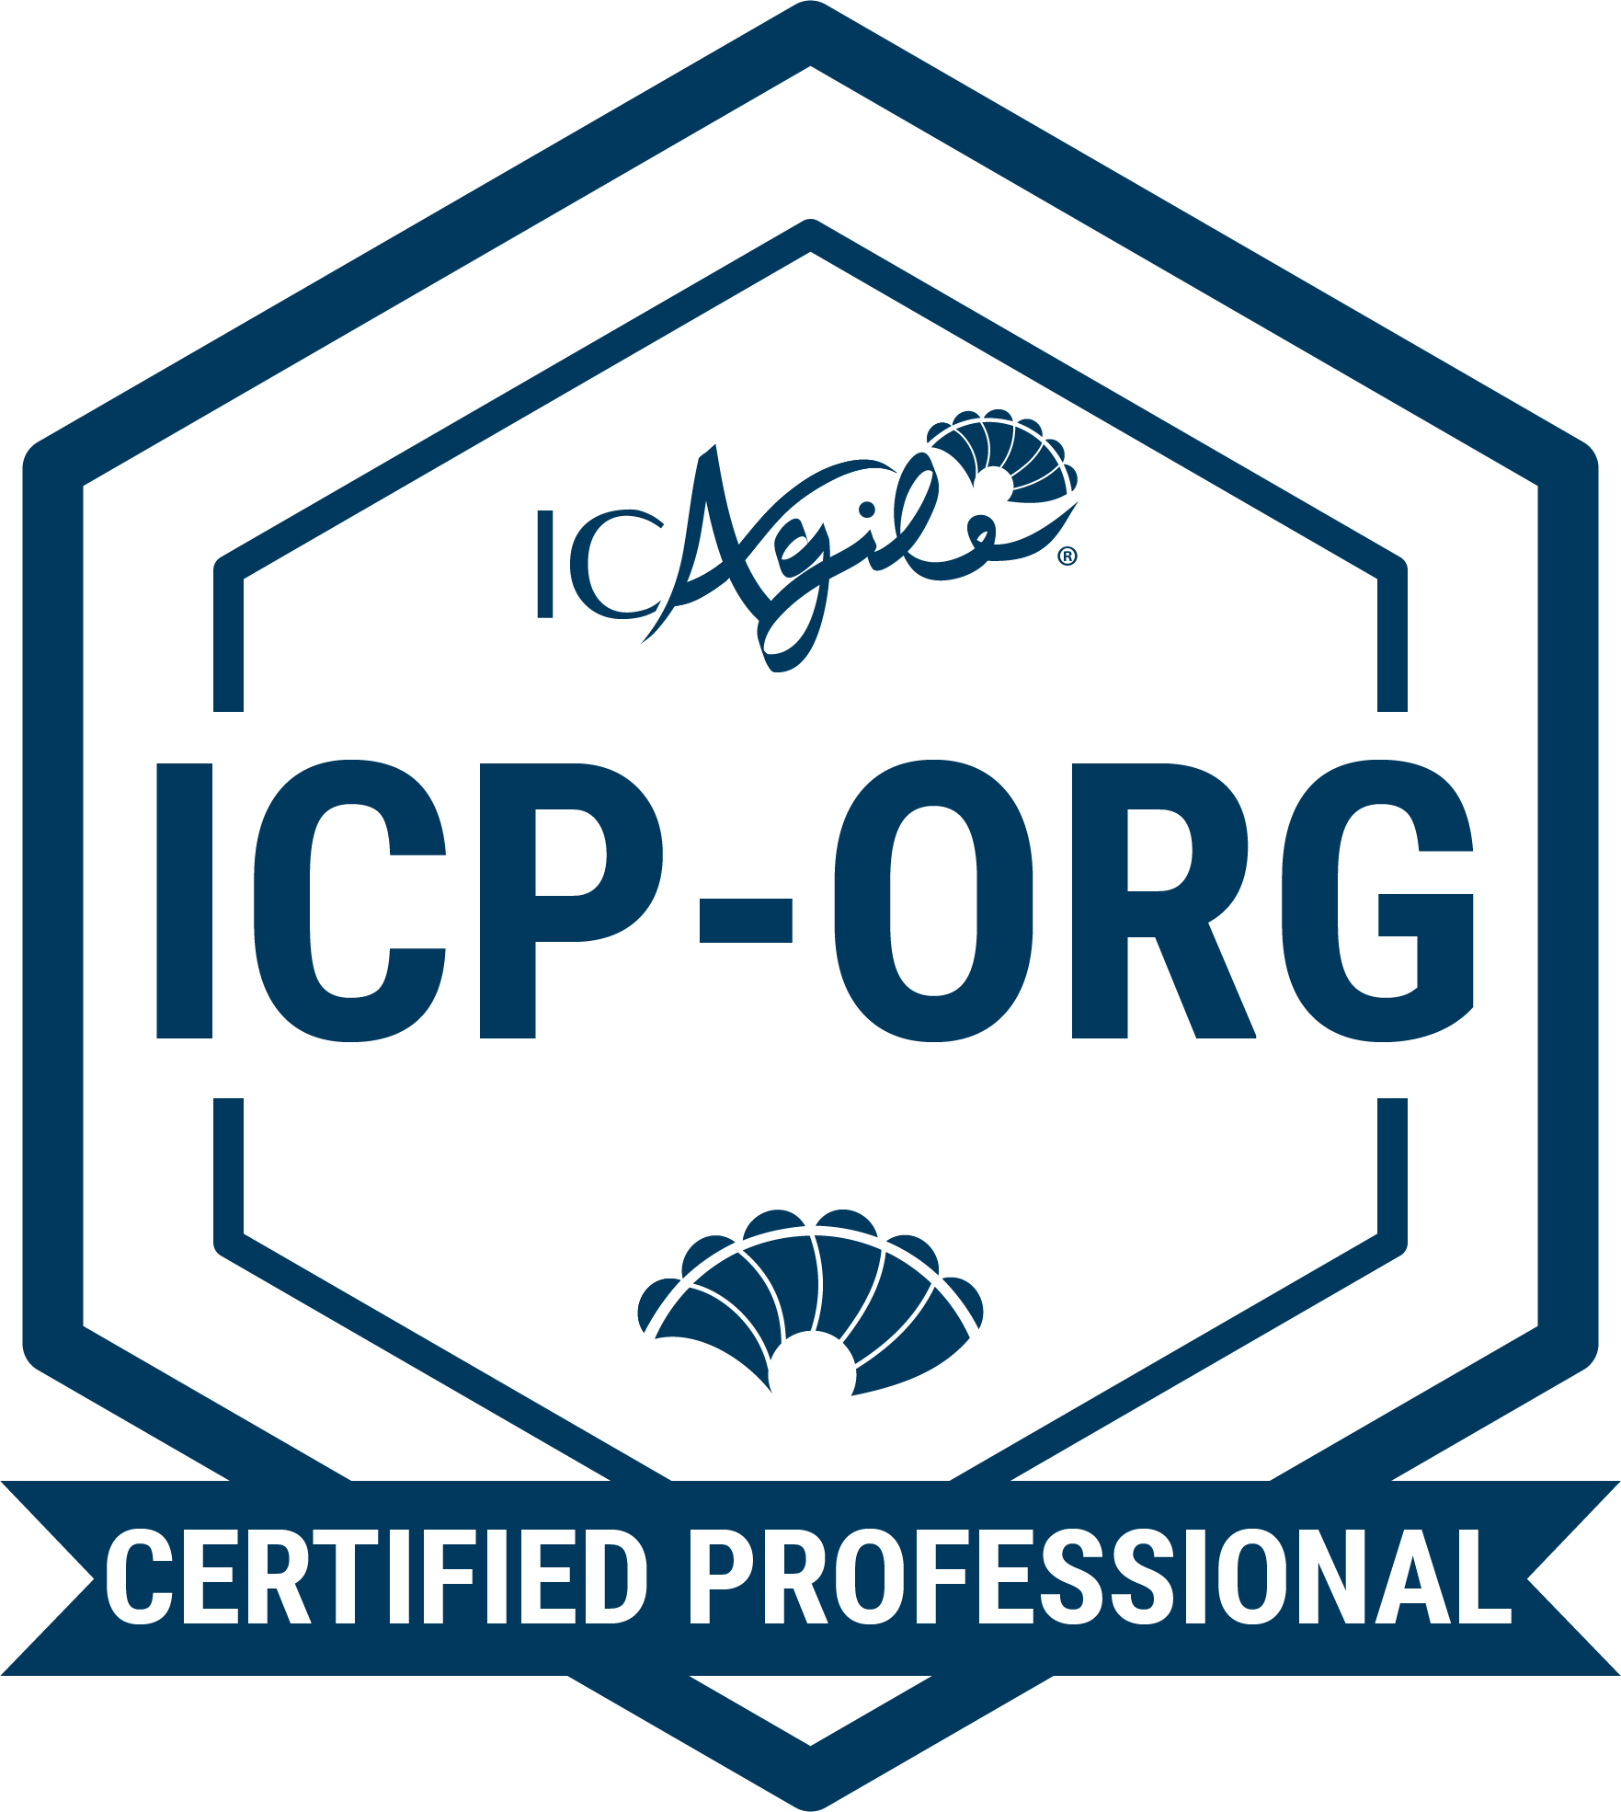
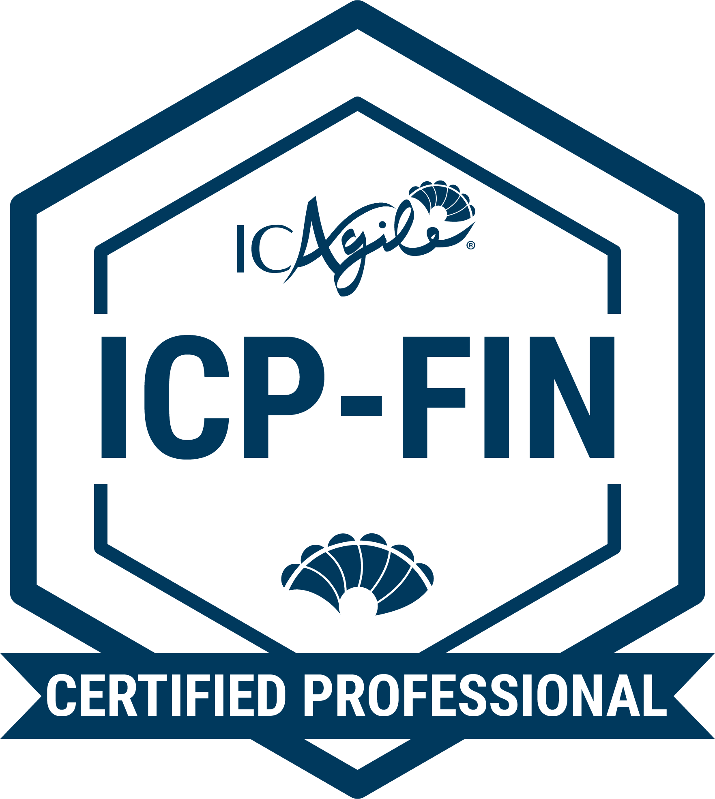
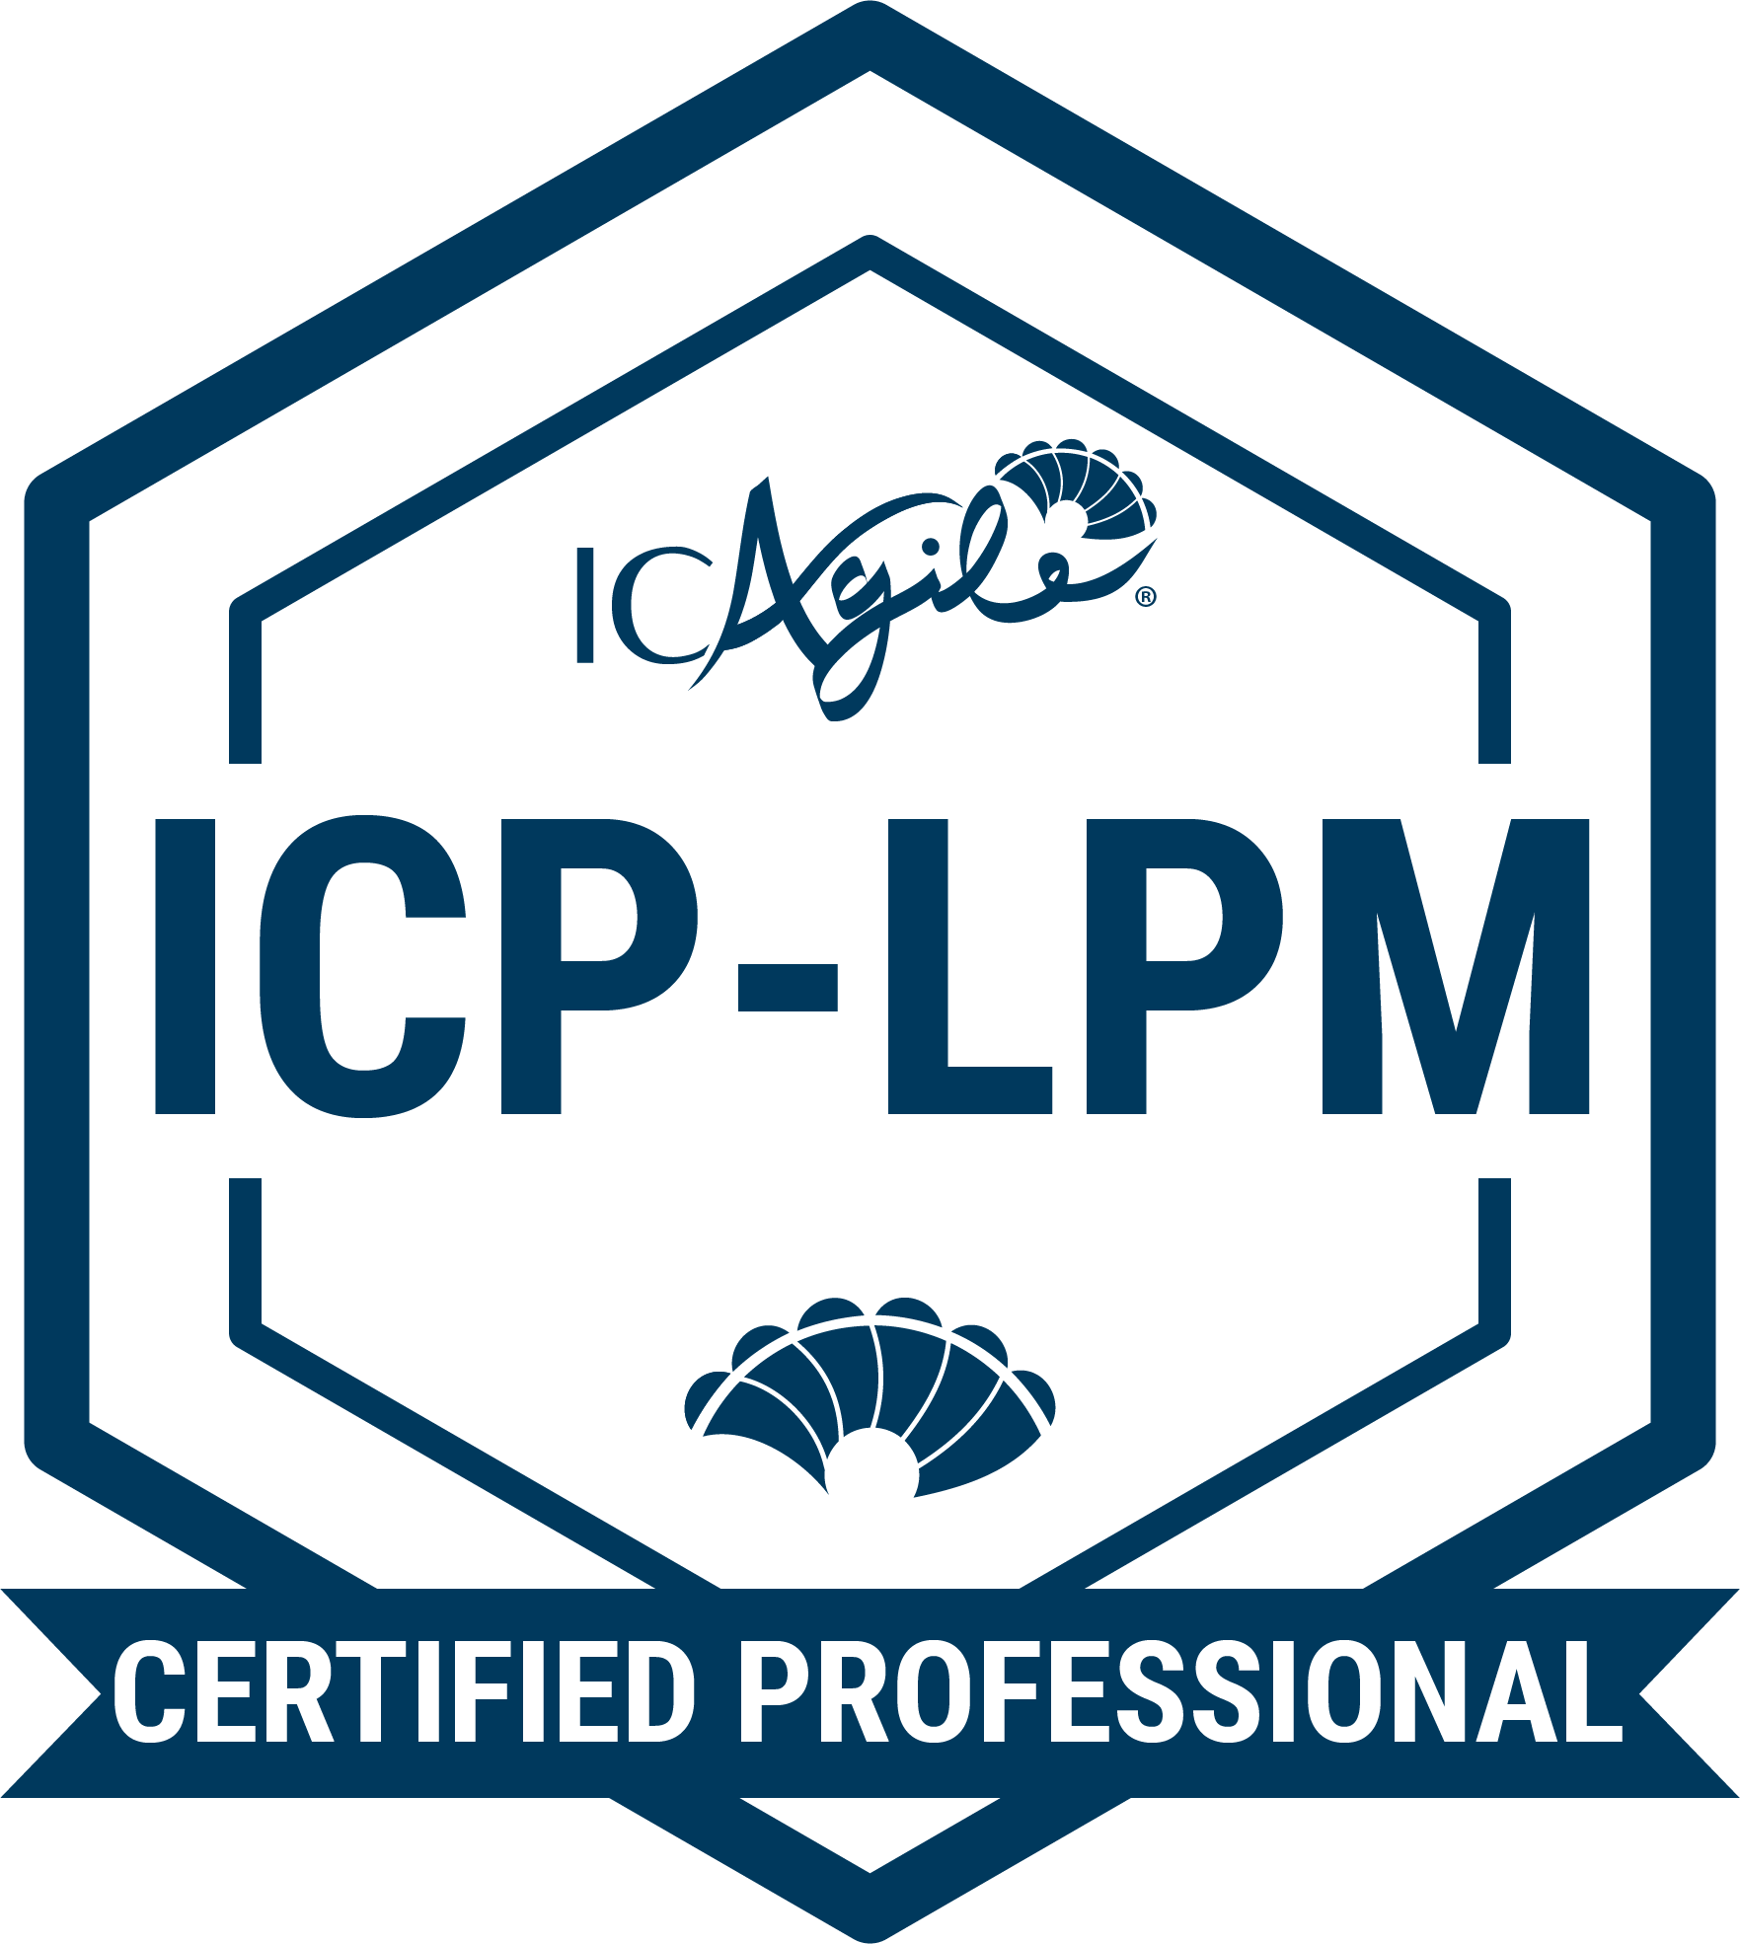
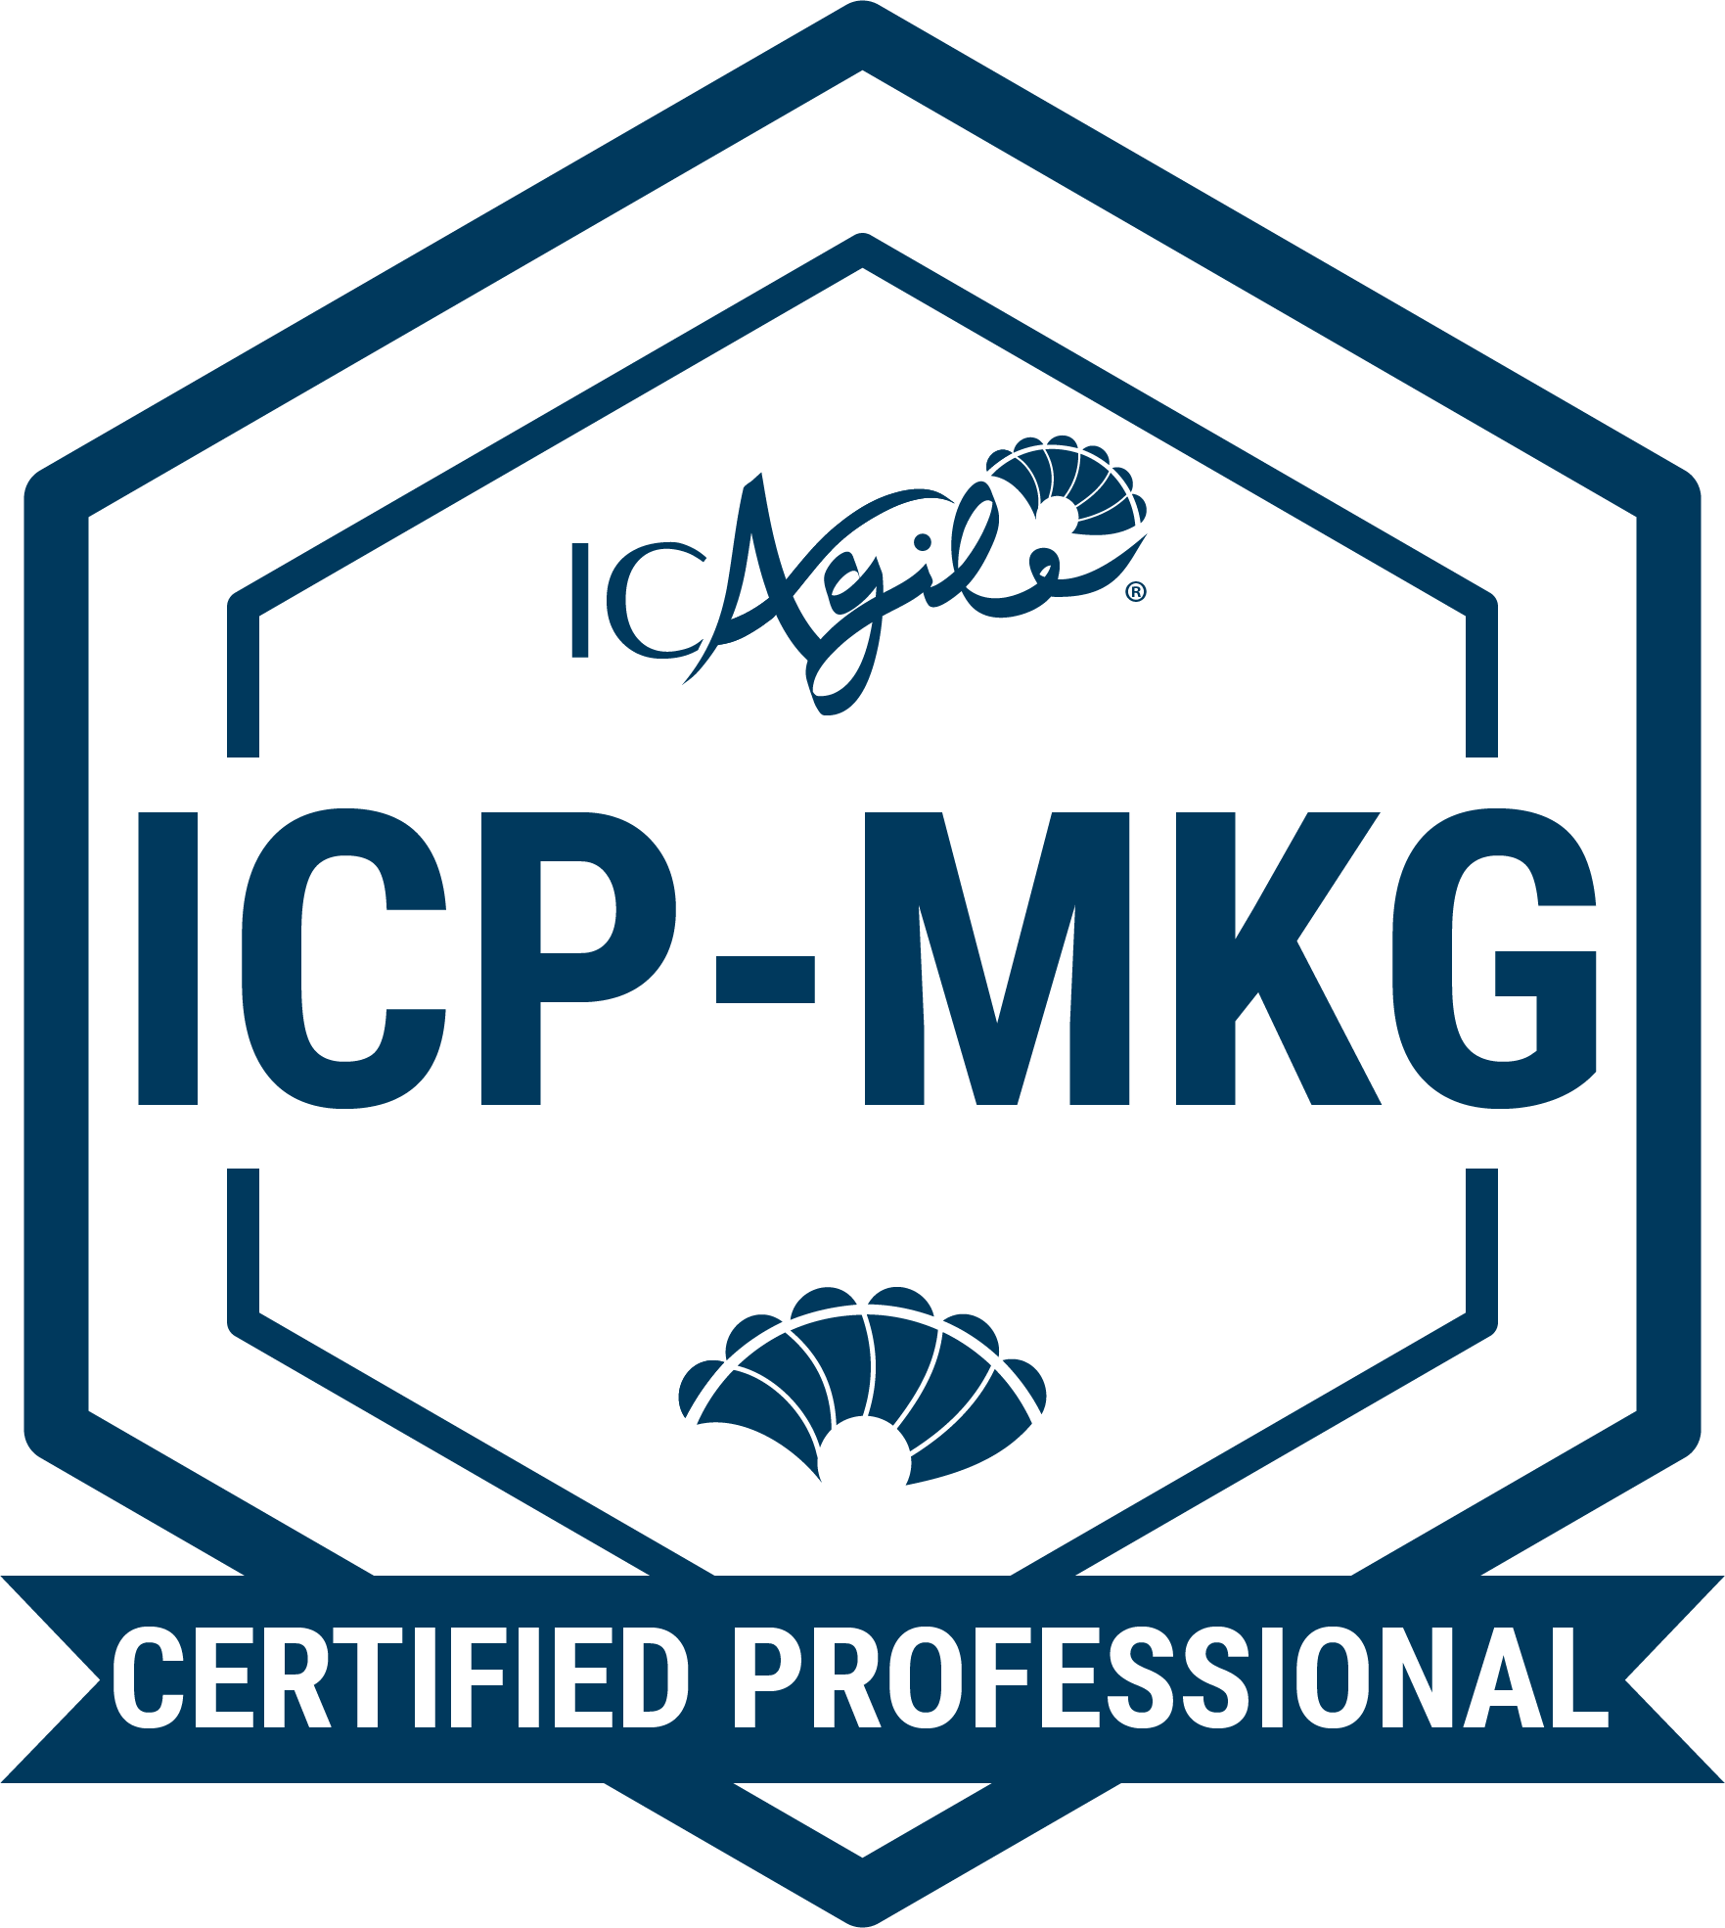
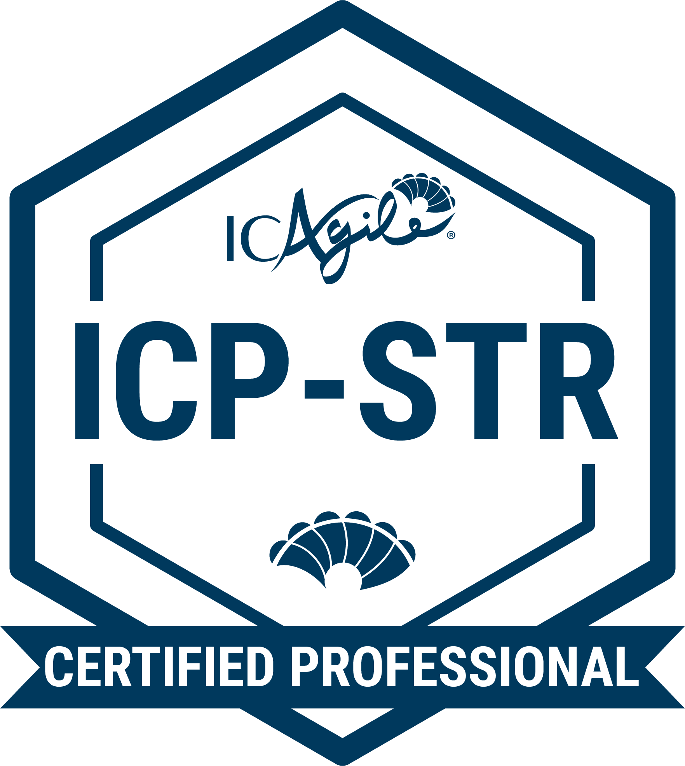
TRACKS IN
ORGANIZATIONAL ENABLEMENT
Agile HR
Business Agility Foundations
Agility in HR
Adaptive Org Design
Agile Finance
Business Agility Foundations
Agility in Finance
Lean Portfolio Management
Agile Marketing
Business Agility Foundations
Agility in Marketing
Adaptive Strategy
Go Back to Learning Programs

Slide 6
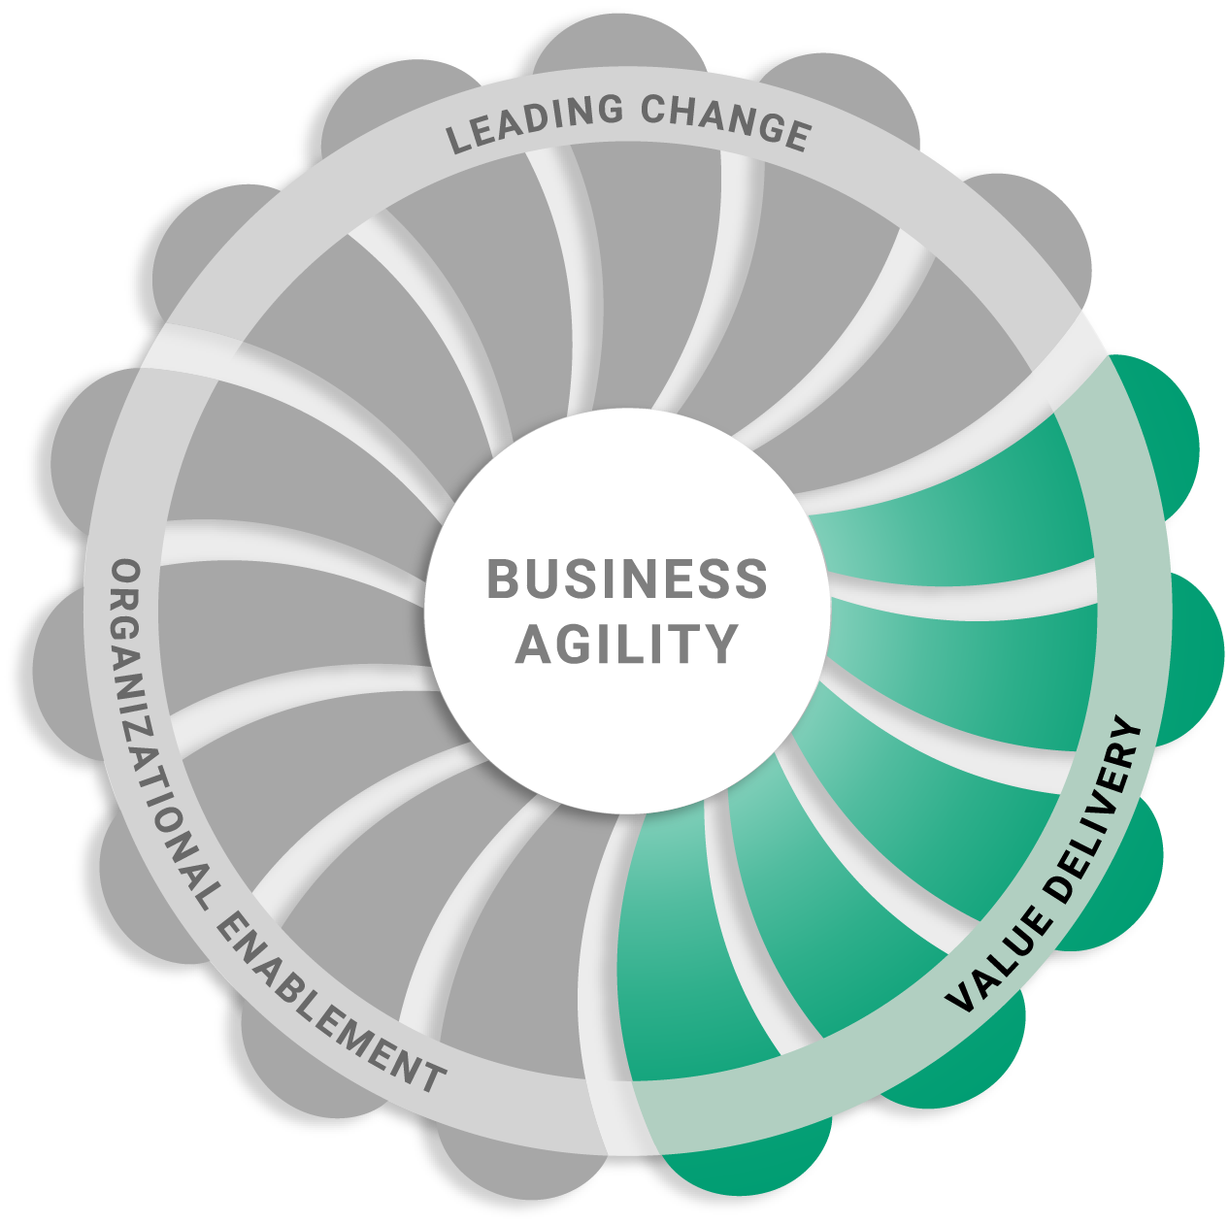
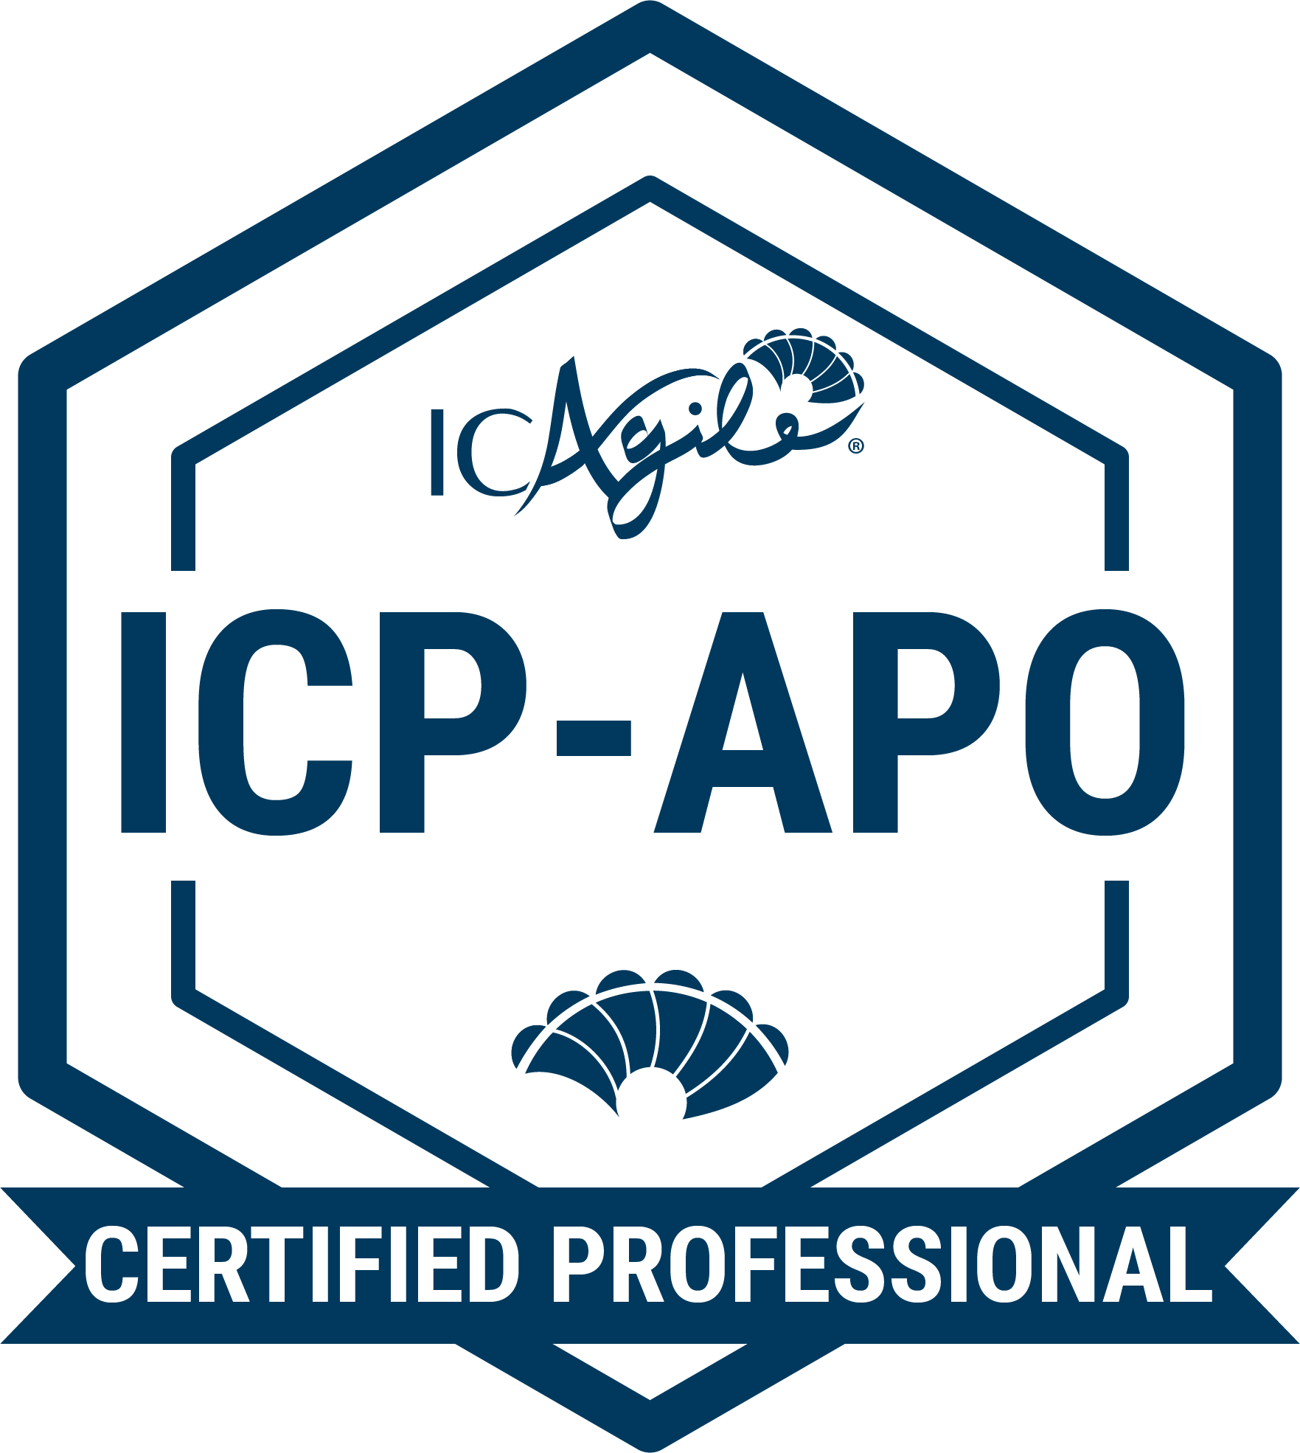
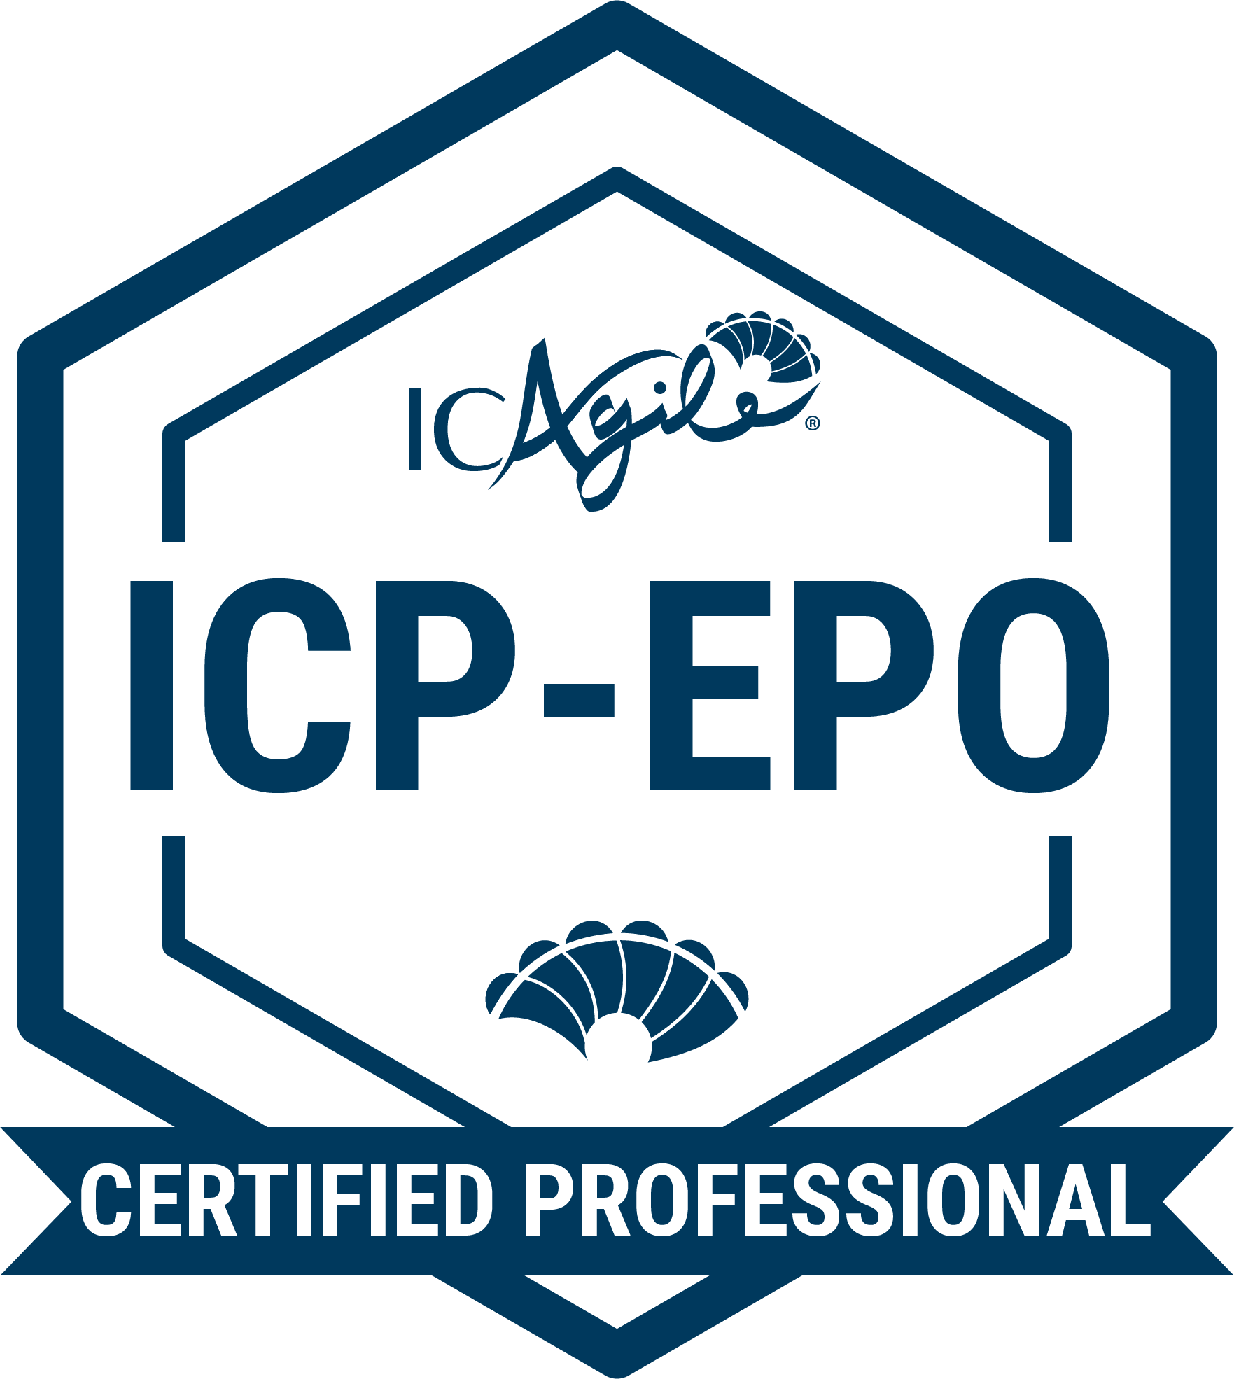
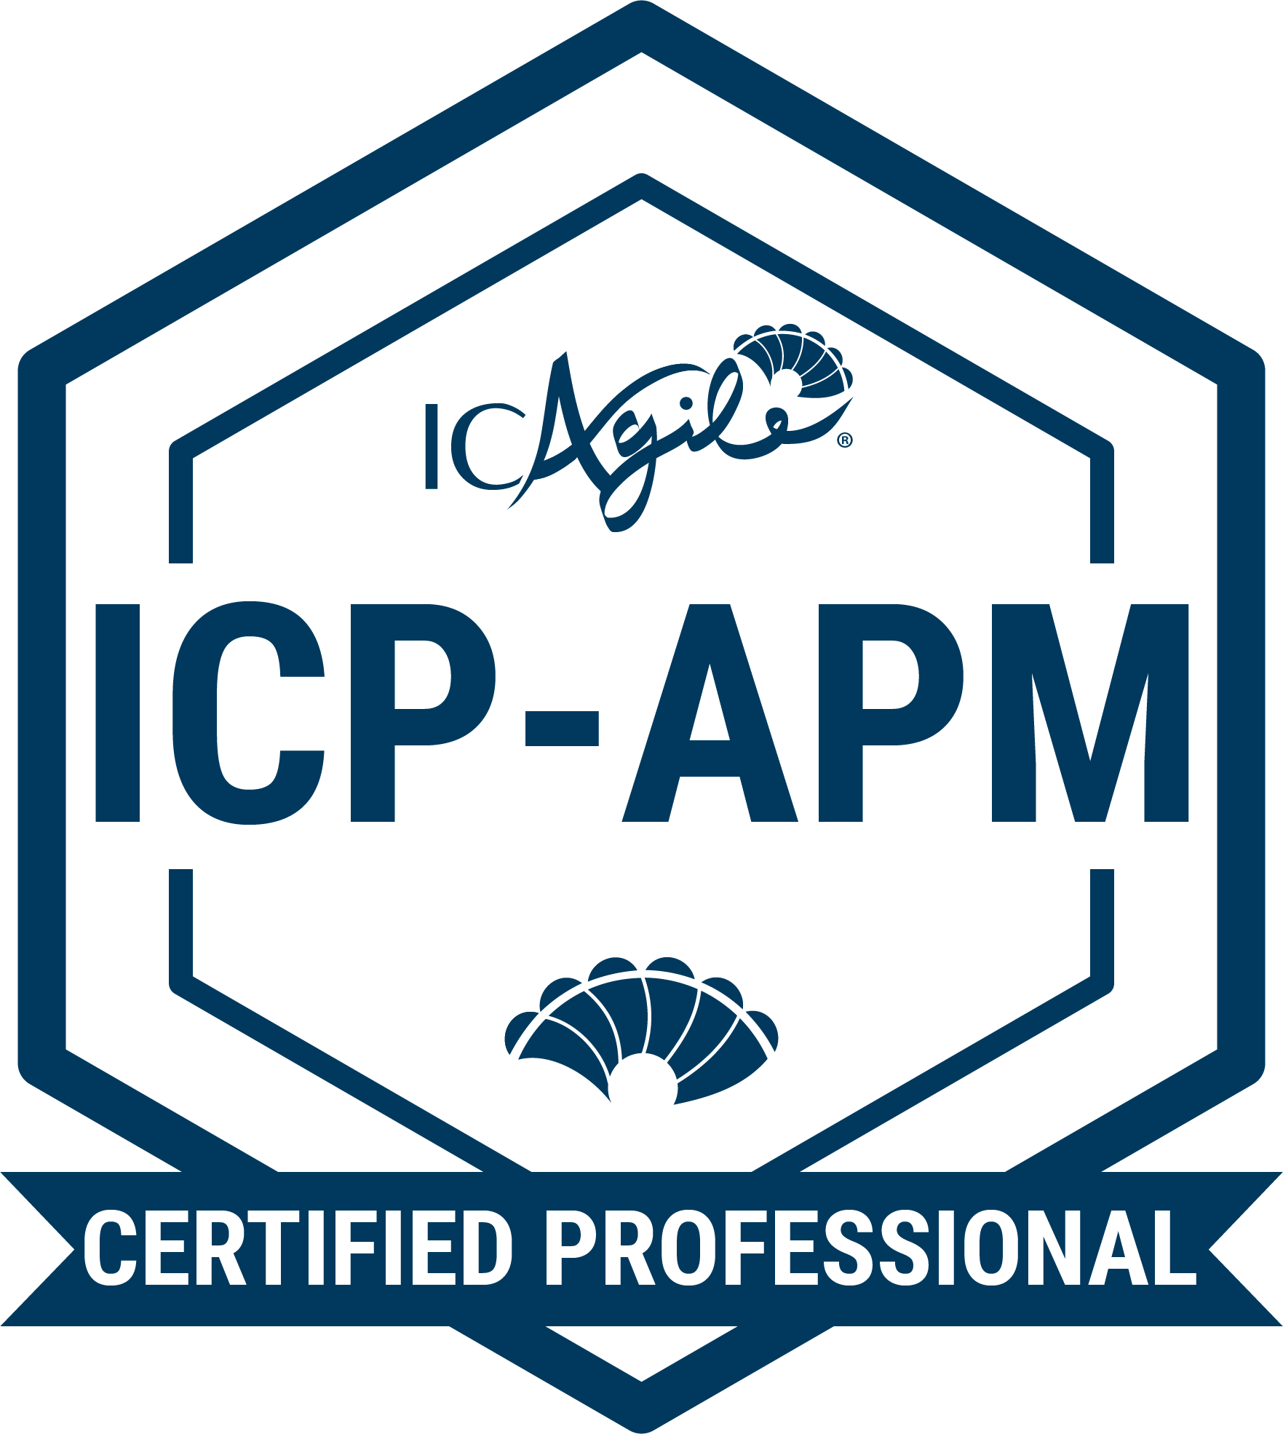
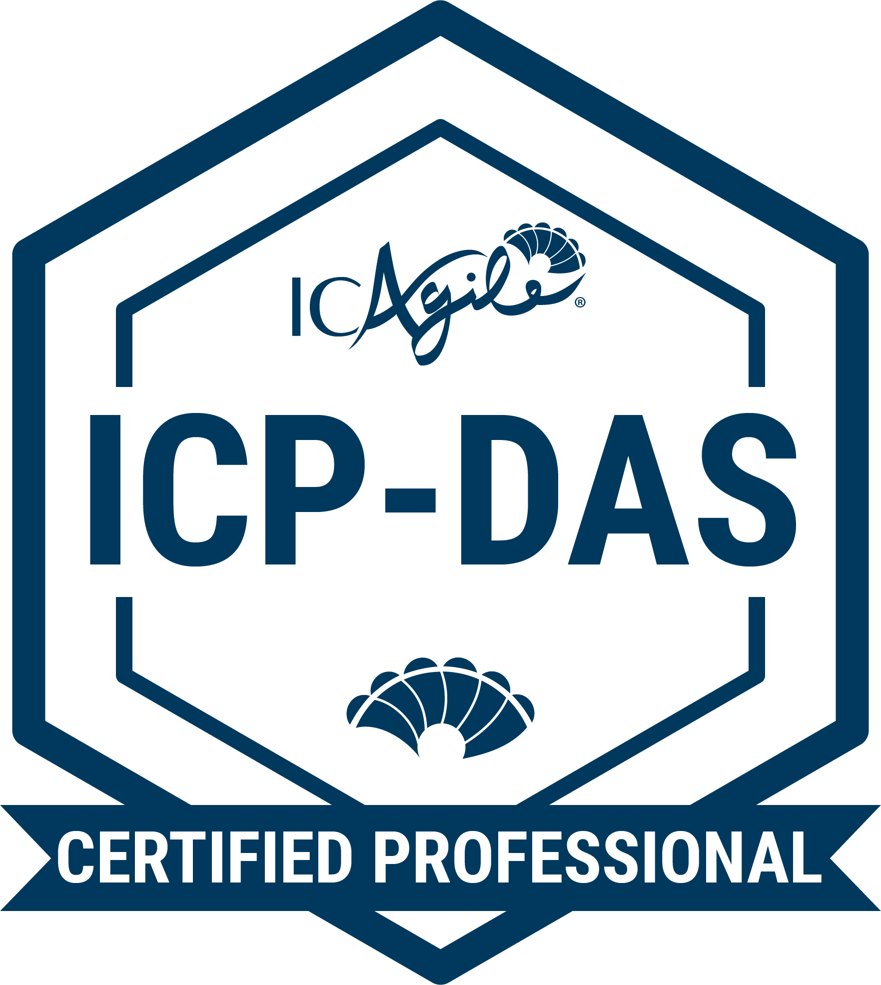
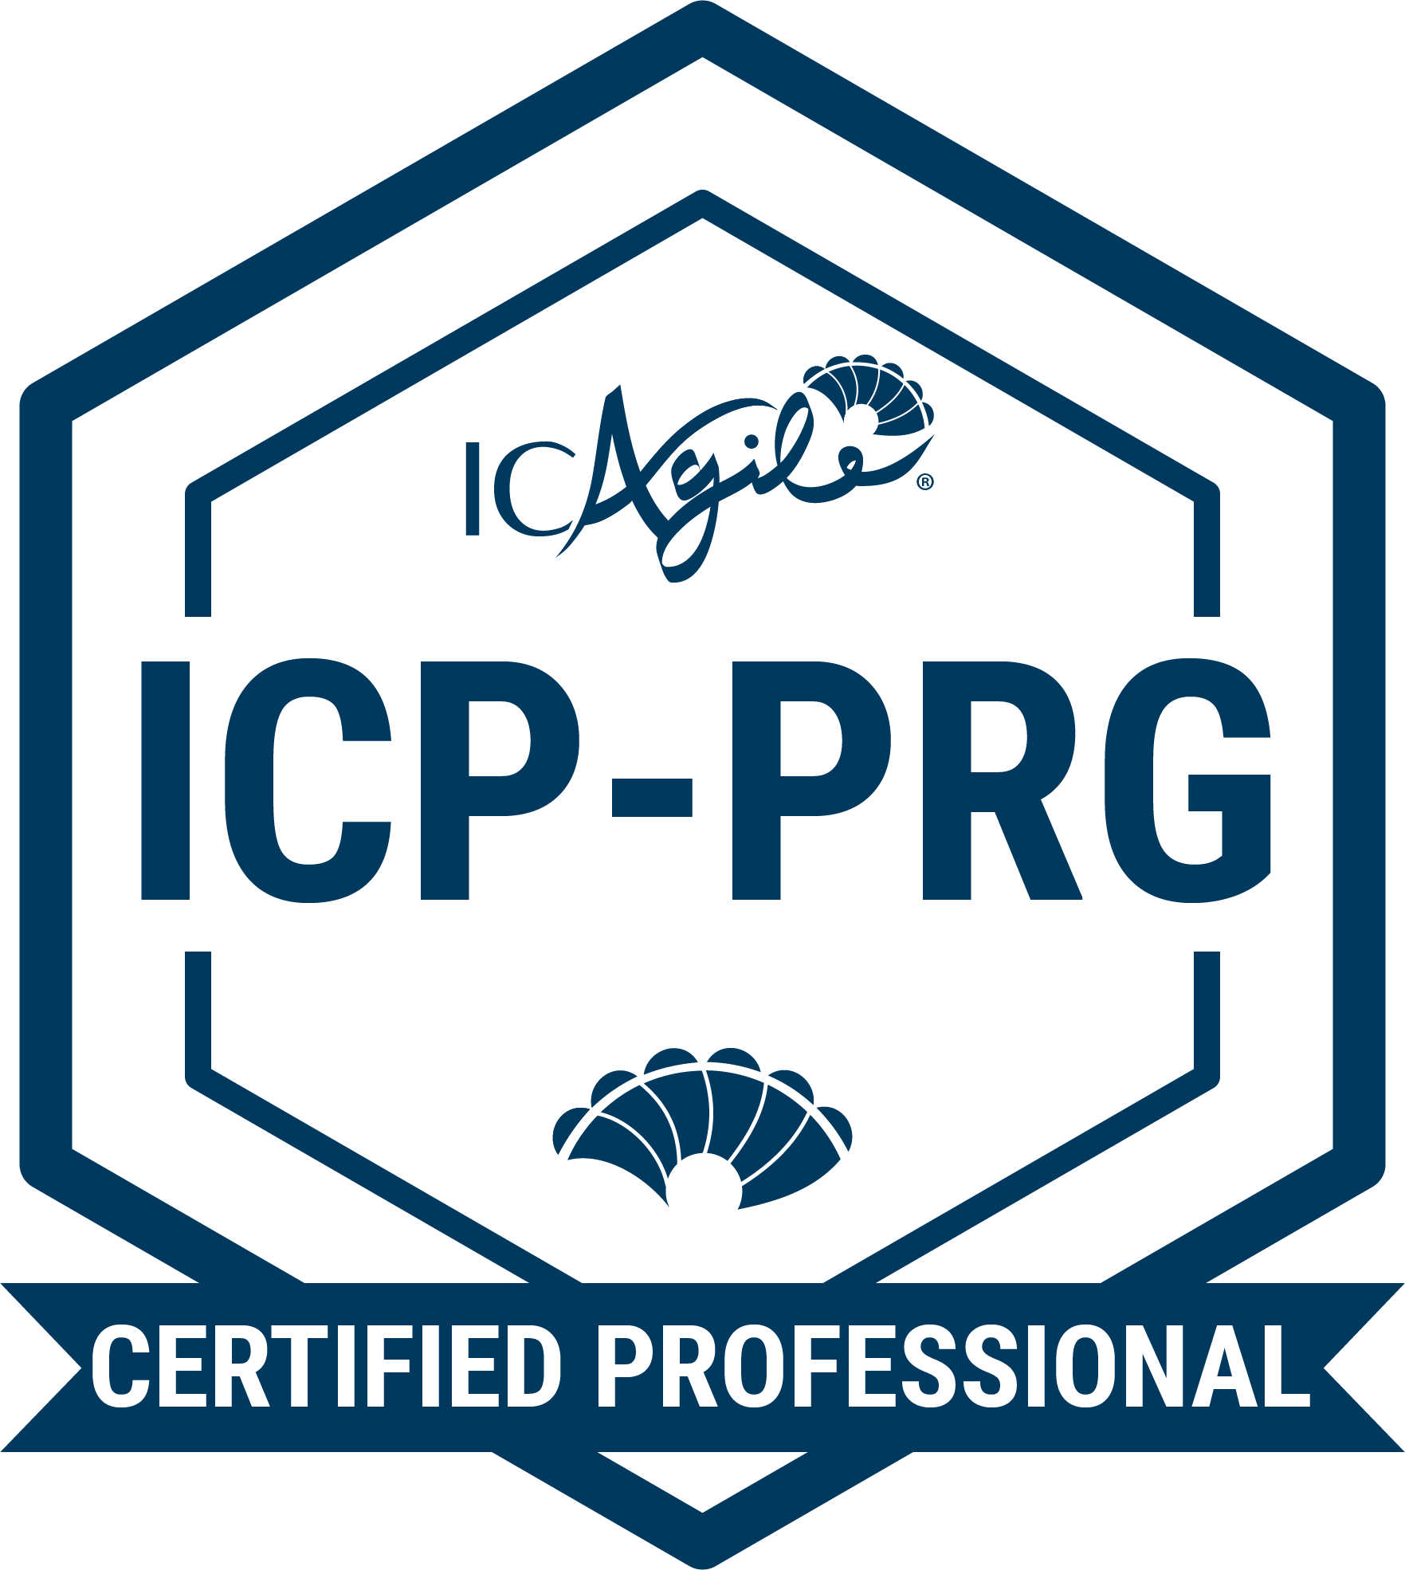
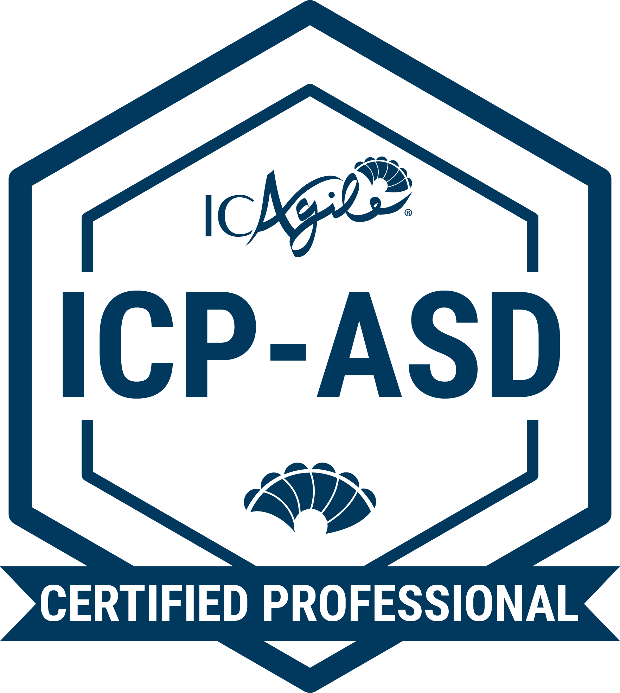
TRACKS IN VALUE DELIVERY
Product Ownership
Agile Fundamentals
Agile Product Ownership
Enterprise Product Ownership
Delivery Management
Agile Fundamentals
Agile Project and Delivery Management
Delivery at Scale
Agile Engineering
Agile Fundamentals
Agile Programming
Agile Software Design
Go Back to Learning Programs

Slide 7
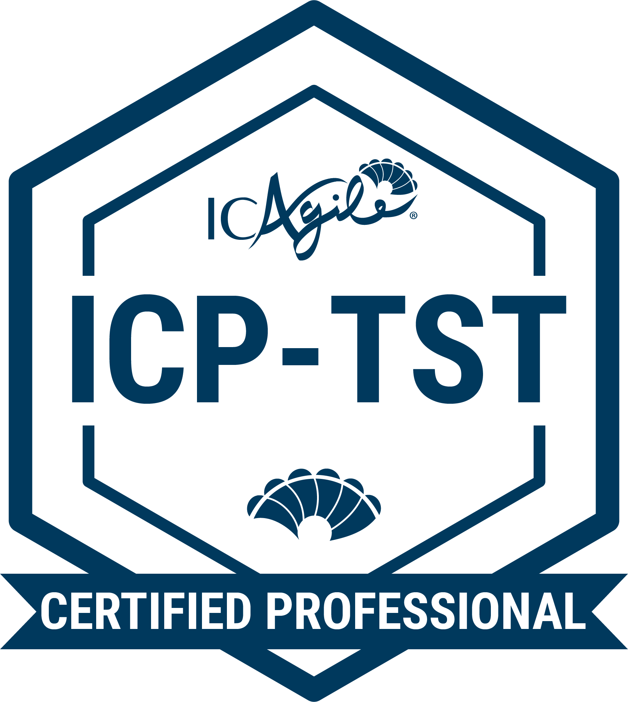
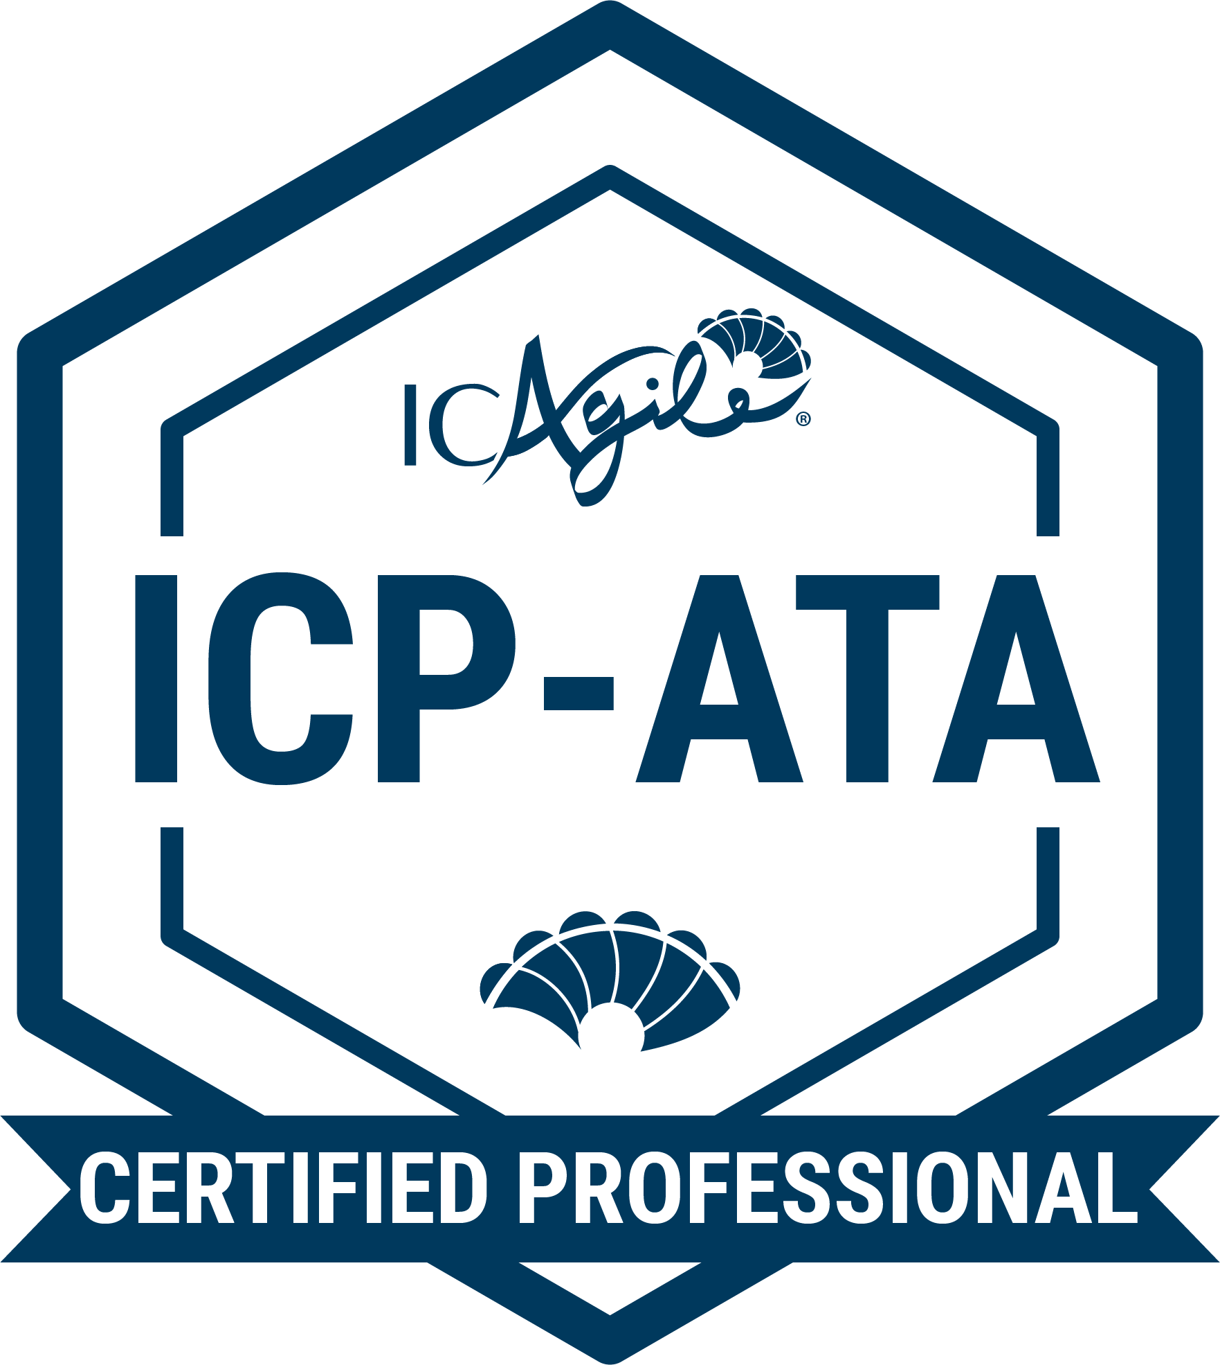
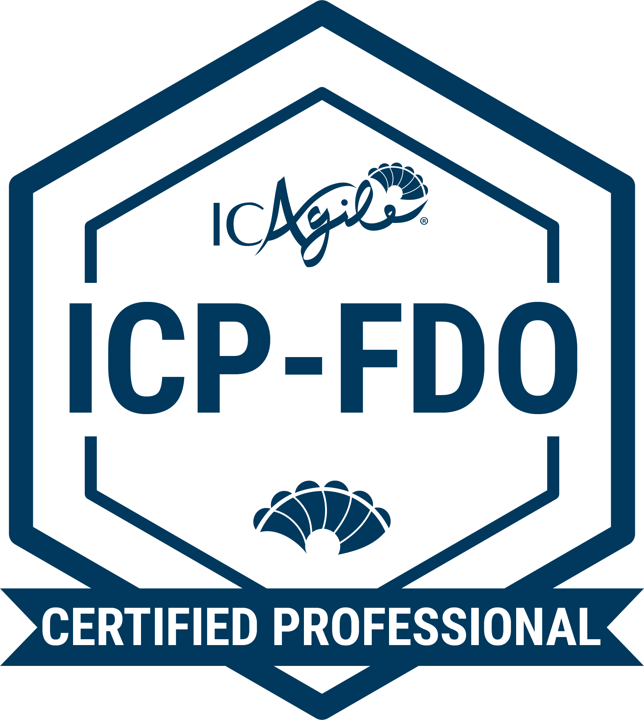
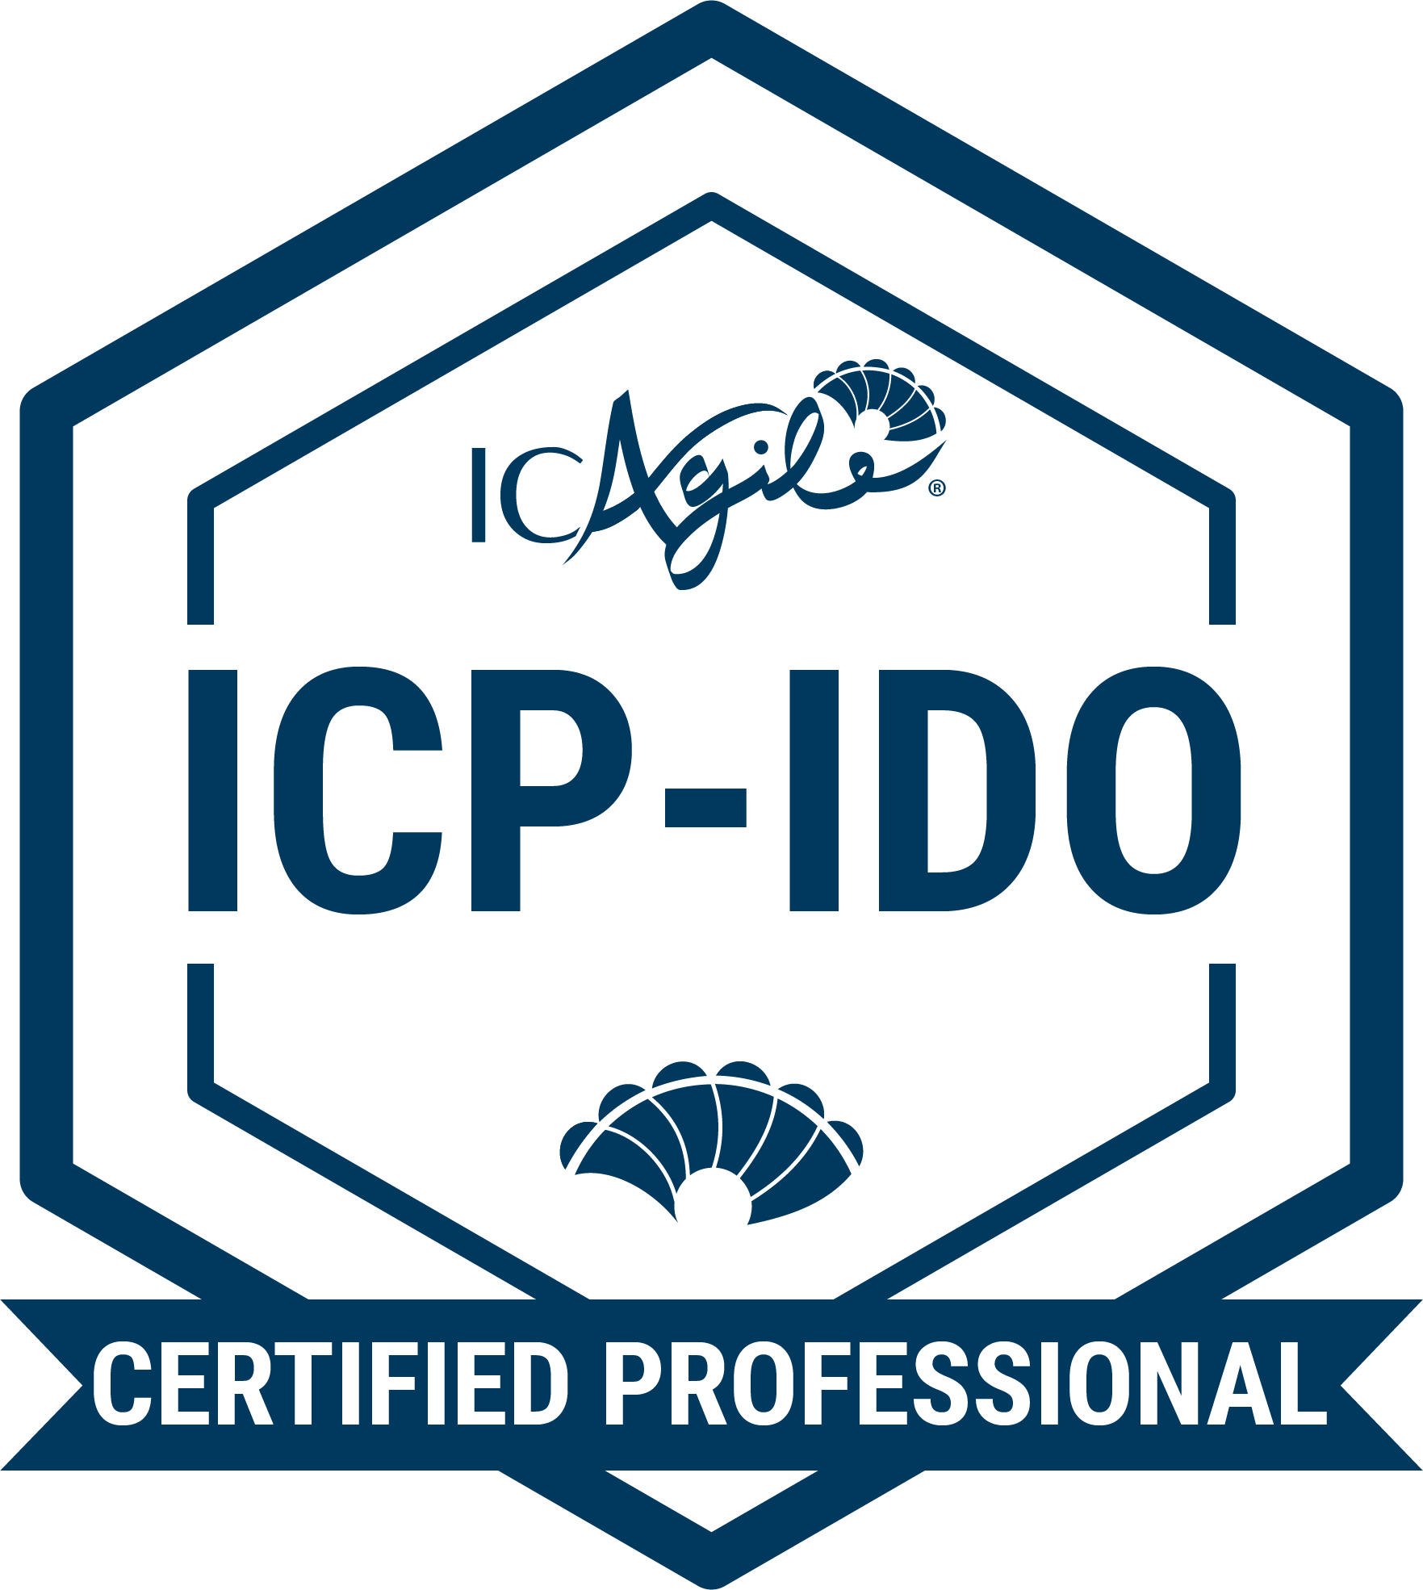
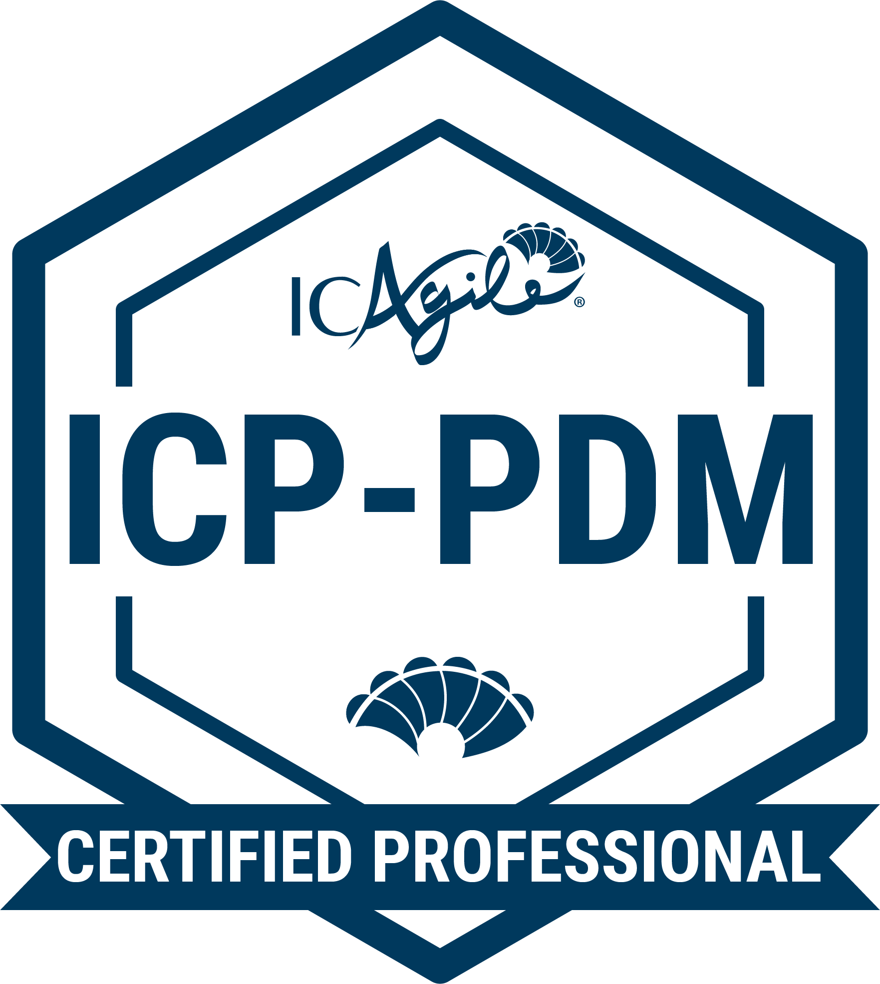
TRACKS IN VALUE DELIVERY
Agile Testing
Agile Fundamentals
Agile Testing
Agile Test Automation
DevOps
Agile Fundamentals
Foundations of DevOps
Implementing DevOps
Product Strategy
Business Agility Foundations
Product Management
Lean Portfolio Management
Go Back to Learning Programs

Slide 8

Agile Fundamentals
ABOUT THIS CERTIFICATION
FEATURED LEARNING OUTCOMES
Agile Fundamentals (ICP) is an industry-recognized credential that demonstrates an understanding of the Agile mindset, values, principles, and foundational concepts. Professionals are grounded in what it means to "be agile while doing agile" and achieve organizational agility without specific focus on any single agile methodology or framework (i.e. Scrum, Kanban, XP, DSDM, SAFe, etc.).
Origins of Agile
Establishing the Agile Mindset
Incremental Development
Product Adaptation
DESIGNED FOR
Professionals who are in technical and product roles and are starting their agile learning journey.
Go Back to Learning Programs

Slide 9
Business Agility Foundations
ABOUT THIS CERTIFICATION
FEATURED LEARNING OUTCOMES
Achieving the ICAgile Certified Professional in Business Agility Foundations (ICP-BAF) demonstrates an ability to articulate the values, principles, and dimensions of business agility. Business agilists can formulate an action plan for applying agility in their workplaces and can appraise and use a variety of frameworks, tools, and techniques to jumpstart the organizational and individual transformation towards a more responsive, value-driven reality.
The Need for Business Agility
Developing a Growth Mindset
Implementing and Sustaining Business Agility
Action Plans and Tools to Accelerate Business Agility
DESIGNED FOR
Professionals who are in business-focused roles and are starting their agile learning journey.
Go Back to Learning Programs

Slide 10
Leading with Agility
ABOUT THIS CERTIFICATION
FEATURED LEARNING OUTCOMES
This knowledge-based designation is an industry-recognized credential that demonstrates knowledge of the key aspects of organizational agility capability and agile leadership. It verifies a firm grasp of the core skills for developing personal agility, relationship agility, and leading change and transformation.
Organizational Agility Capability
Leadership Styles
Emotional Intelligence in Relationships
Leader as Agent of Transformation
PART OF THE AGILITY IN LEADERSHIP TRACK
DESIGNED FOR
Leaders and emerging leaders at all career and organizational levels.
Go Back to Learning Programs

Slide 11
People Development
ABOUT THIS CERTIFICATION
FEATURED LEARNING OUTCOMES
This designation demonstrates a leader’s commitment to grow others and to create environments in their organization where individuals, teams, and teams of teams thrive. They understand the importance of creating a container of generative learning to enable people, the organization and its agility.
People as the Catalyst for Agility
Cultivating a Culture of Learning
Hire to Elevate, not Delegate
Leadership at Every Level
PART OF THE AGILITY IN LEADERSHIP TRACK
DESIGNED FOR
Leaders and emerging leaders at all career and organizational levels.
Go Back to Learning Programs

Slide 12
COMING SOON
Expert in Agility in Leadership
ABOUT THIS CERTIFICATION
FEATURED LEARNING OUTCOMES
Some of the key competencies covered by this certification will include building adaptive capability in organizations, leading people and managing systems through complexity and uncertainty, and developing leadership in others.
The ICE-AL is currently being developed by our community of thought leaders.
PART OF THE AGILITY IN LEADERSHIP TRACK
DESIGNED FOR
Leaders at all levels in the organization who want to build leadership competencies that will support transformational journeys for people and organizations. It is for professionals who recognize that leadership is a role within functioning systems rather than a specific position.
Go Back to Learning Programs

Slide 13
Agility in the Enterprise
ABOUT THIS CERTIFICATION
FEATURED LEARNING OUTCOMES
As one of ICAgile’s most advanced knowledge-based certifications, the ICP-ENT designation validates an understanding of agility at the enterprise level from structural, process, leadership, and cultural perspectives.
Understanding Systems and Complexity Theory
Extending Agility to the Enterprise
Adaptive Principles and Patterns for Organizational Design
Understanding and Working with Executive Teams
PART OF THE ENTERPRISE COACHING TRACK
DESIGNED FOR
Agile coaches at the enterprise, portfolio, program, or team level.
Go Back to Learning Programs

Slide 14
Coaching Agile Transitions
ABOUT THIS CERTIFICATION
FEATURED LEARNING OUTCOMES
This designation is one of ICAgile’s most advanced knowledge-based certifications. It demonstrates an understanding of the skills and competencies needed to become an Enterprise Agile Coach.
Understanding Enterprise Coaching for Agility
Creating a Business Case for Change
Components and Considerations of Organizational Assessments
Understanding, Identifying, and Addressing Organizational Impediments
PART OF THE ENTERPRISE COACHING TRACK
DESIGNED FOR
Agile coaches at the enterprise, portfolio, program, or team level.
Go Back to Learning Programs

Slide 15
Expert in Enterprise Coaching
ABOUT THIS CERTIFICATION
FEATURED COMPETENCIES
This competency-based designation represents an advanced standard for disciplinary capability. It requires successful completion of an Accredited Expert Program that guides qualified candidates on a journey to build competence over time alongside a cohort of peers. Earning an ICE-EC verifies the skills required to be an effective practitioner in the discipline of Enterprise Coaching.
Designs the Change Strategy
Develops Transformational Leaders
Coaches Individuals and Systems
Designs Organizational Structures
PART OF THE ENTERPRISE COACHING TRACK
DESIGNED FOR
Enterprise, program, and team-level Agile Coaches who are eager to build competencies alongside a cohort to become an effective Enterprise Coach.
Go Back to Learning Programs

Slide 16
Agile Team Facilitation
ABOUT THIS CERTIFICATION
FEATURED LEARNING OUTCOMES
The Agile Team Facilitation certification is an industry-recognized credential that demonstrates an understanding of group facilitation tools and techniques for effectively designing meetings and workshops that both engage the entire audience and drive towards agreed-upon outcomes.
  The Facilitation Mindset
  Facilitating Collaborative Conversations
  Facilitating Selected Agile Meetings
  Adjusting Facilitation Given Team Maturity
PART OF THE AGILE TEAM COACHING TRACK
DESIGNED FOR
Current or aspiring agile coaches, scrum masters, product owners, agile managers, and project managers.
Go Back to Learning Programs

Slide 17
Agile Coaching
ABOUT THIS CERTIFICATION
FEATURED LEARNING OUTCOMES
Designed by key thought leaders who defined the discipline of agile coaching, the Agile Coaching certification verifies an understanding of the tools, skills, and techniques needed to coach agile teams.
Conducting the Coaching Conversation
Contrasting Mentoring with Coaching
Helping Team Members Experience the Agile
Mindset Shifts
Leadership Engagement
PART OF THE AGILE TEAM COACHING TRACK
DESIGNED FOR
Current or aspiring agile coaches, scrum masters, product owners, agile managers, and project managers.
Go Back to Learning Programs

Slide 18
Expert in Agile Coaching
ABOUT THIS CERTIFICATION
FEATURED COMPETENCIES
This competency-based designation verifies competencies in key skills that are imperative to becoming an effective agile coach. ICE-AC distinguishes professionals who can facilitate, coach, mentor, and teach at a level that can unlock the potential of agile teams.
Uses Agile Subject Matter Expertise to Adapt Agile Practices Being Facilitated
Holds Space for an Agile team to Deepen its Learning and Reach Desired Outcomes
Develops Teams While Effectively Dealing with Complex Situations
Relays a New Concept or Technique in a Meaningful Way
PART OF THE AGILE TEAM COACHING TRACK
DESIGNED FOR
Agile coaches who have a passion for servant leadership and a desire to build competencies in facilitation, professional coaching, mentoring, and teaching in service of agile teams.
Go Back to Learning Programs

Slide 19
Systems Coaching
ABOUT THIS CERTIFICATION
FEATURED LEARNING OUTCOMES
This certification outlines key concepts in Systems Coaching and how to apply them within any organizational context. It helps agile team coaches, enterprise coaches, and leaders improve their ability to work with complex organizational systems and is recommended for
professionals who are embarking on the Agile Team Coaching, Enterprise Coaching, Agility in Leadership tracks.
Systems Thinking
What is Systems Coaching?
Professional Coaching for Systems Coaches
Facilitation for Systems Coaches
RECOMMENDED AS PART THE FOLLOWING TRACKS
DESIGNED FOR
Agility in Leadership
Enterprise Coaching
Agile Team Coaching
Agile team coaches, enterprise coaches, and leaders who want to learn how to work with and coach systems.
Go Back to Learning Programs

Slide 20
Product Management
ABOUT THIS CERTIFICATION
FEATURED LEARNING OUTCOMES
This certification validates the skills required to discover, position, and deliver winning products in a competitive landscape. Product Management professionals take a strategic and external-facing view of the product life cycle to align product strategy with their organization’s purpose and customers’ needs.
The Product Lifecycle
Metrics that Matter for Products
Designing Hypothesis Tests and Experiments
Teams Across the Product Lifecycle
PART OF THE PRODUCT STRATEGY TRACK
DESIGNED FOR
Product managers, product owners, and portfolio managers.
Go Back to Learning Programs

Slide 21
Agile Product Ownership
ABOUT THIS CERTIFICATION
FEATURED LEARNING OUTCOMES
Achieving the Agile Product Ownership certification validates knowledge to effectively deliver valuable software, products, and services through key agile practices. Designees can create organizational and team environments conducive to frequent and transparent collaboration between customers, business stakeholders, and development teams.
Product Ownership as an Agile Discipline and Craft
Skills and Behaviors for Agile Product Ownership
Analyze to Determine Value
Enabling Valuable Delivery
PART OF THE PRODUCT OWNERSHIP TRACK
DESIGNED FOR
Business analysts, product owners, and product managers.
Go Back to Learning Programs

Slide 22
Enterprise Product Ownership
ABOUT THIS CERTIFICATION
FEATURED LEARNING OUTCOMES
The Enterprise Product Ownership certification effectively validates one’s knowledge to eliminate silos, align value delivery to corporate vision and strategy, and engage stakeholders at broad levels.
Enterprise Product Ownership Context
Skills and Behaviors for Enterprise Product Ownership
Defining Enterprise Value
Analyzing Beyond an Initiative
PART OF THE PRODUCT OWNERSHIP TRACK
DESIGNED FOR
Business analysts, product owners, and product managers.
Go Back to Learning Programs

Slide 23
Agile Project and Delivery Management
ABOUT THIS CERTIFICATION
FEATURED LEARNING OUTCOMES
The Agile Project and Delivery Management certification verifies that the holder possesses the skills for successful Lean and Agile product delivery using various approaches, including projects and value-streams. The learner will be able to identify dependencies and blockers, enable rapid feedback and learning, and facilitate incremental value delivery.
Delivery Agility
Manage the System, Empower the Team
Deliver Value Continuously
Planning and Monitoring
PART OF THE DELIVERY MANAGEMENT TRACK
DESIGNED FOR
Delivery managers and delivery team leads.
Go Back to Learning Programs

Slide 24
Delivery at Scale
ABOUT THIS CERTIFICATION
FEATURED LEARNING OUTCOMES
This certification demonstrates an individual’s skills to apply agile management skills to enterprise-level product development using value-streams, projects, and programs. It validates proficiency in organizing effective outcomes, eliminating waste, maximizing value-delivery, and communicating value and progress across an organization.
Optimize the System
Empower the Organization to Deliver
Align Value Delivery at Scale
PART OF THE DELIVERY MANAGEMENT TRACK
DESIGNED FOR
Delivery managers and delivery team leads.
Go Back to Learning Programs

Slide 25
Agile Programming
ABOUT THIS CERTIFICATION
FEATURED LEARNING OUTCOMES
Earning the Agile Programming (ICP-PRG) certification demonstrates the ability to inspect and adapt code efficiently and effectively to accommodate new insights, product changes, and technical innovations. Designees know how to move away from traditional waterfall development and into developer collaboration techniques, like pair programming and collective code ownership.
Refactoring and Legacy Code Management
Acceptance Testing and Automated Tests
Collaborative and Test-Driven Development
Version Control and Continuous Integration
PART OF THE AGILE ENGINEERING TRACK
DESIGNED FOR
Software developers, application programmers, systems designers, technical architects, development managers, and technical leads.
Go Back to Learning Programs

Slide 26
Agile Software Design
ABOUT THIS CERTIFICATION
FEATURED LEARNING OUTCOMES
The Agile Software Design certification distinguishes professionals who can respond to customer goals, analyze the impact of technical debt, and determine the level of design needed at various stages of an agile project development cycle.
Effective Software Design
Sequencing Work throughout the Agile Lifecycle
Technical Leadership Skills
Applying Continuous Delivery
PART OF THE AGILE ENGINEERING TRACK
DESIGNED FOR
Software developers, application programmers, systems designers, technical architects, development managers, and technical leads.
Go Back to Learning Programs

Slide 27
Agile Testing
ABOUT THIS CERTIFICATION
FEATURED LEARNING OUTCOMES
This certification verifies that the recipient possesses the capability to apply the agile mindset to software testing in a real world environment. The Agile tester has the knowledge to identify key elements of the agile testing mindset, design testing based on features and user stories, and provide risk-based feedback on the quality of products through effective testing techniques.
Agile Testing Mindset
Testing Techniques
Agile Testing Process
PART OF THE AGILE TESTING TRACK
DESIGNED FOR
Agile testers, test engineers, test managers, developers, technical leads.
Go Back to Learning Programs

Slide 28
Agile Test Automation
ABOUT THIS CERTIFICATION
FEATURED LEARNING OUTCOMES
The industry-recognized certification validates knowledge of preparing and implementing test automation in an agile development and/or continuous integration environment.
Test Automation Strategy
Continuous Integration
Automated Story and Feature Testing
Automation Support for Integration and System Testing
PART OF THE AGILE TESTING TRACK
DESIGNED FOR
Agile testers, test engineers, test managers, developers, technical leads.
Go Back to Learning Programs

Slide 29
Foundations of DevOps
ABOUT THIS CERTIFICATION
FEATURED LEARNING OUTCOMES
The Foundations of DevOps certification demonstrates an individual's mindset change from traditional software development to agile and collaborative approaches by delivering software with the Operations team. Holders can show how DevOps leads to effectively coding, testing, scaling, and releasing software continuously.
The Case For DevOps
Configuration Management
Continuous Integration
Continuous Delivery
Operations
PART OF THE DEVOPS TRACK
DESIGNED FOR
Developers, testers, operations leads, DevOps engineers, and site reliability engineers.
Go Back to Learning Programs

Slide 30
Implementing DevOps
ABOUT THIS CERTIFICATION
FEATURED LEARNING OUTCOMES
Implementing DevOps is the next step for learners who want to apply their knowledge of DevOps. It verifies a professional’s ability to plan, build, monitor, and mature the CI/CD pipeline.
Planning the Pipeline
Building the Pipeline
Monitoring the Pipeline
Maturing the Pipeline
PART OF THE DEVOPS TRACK
DESIGNED FOR
Developers, testers, operations leads, DevOps engineers, and site reliability engineers.
Go Back to Learning Programs

Slide 31
Lean Portfolio Management
ABOUT THIS CERTIFICATION
FEATURED LEARNING OUTCOMES
This certification designates the ability to visualize, manage, and guide work to deliver value to customers, enable sustainability for the organization, and respond effectively to the changing business ecosystem.
The What and Why of Lean Portfolio Management
Align Execution to Strategy
Governing and Measuring LPM
Continuous Planning and Delivering
PART OF THE FOLLOWING TRACKS
DESIGNED FOR
Product Strategy Track
Agile Finance Track
Product managers, product owners, portfolio managers, finance professionals, procurement professionals, business managers and executives, compliance professionals, accountants, and sales professionals.
Go Back to Learning Programs

Slide 32
Agility in HR
ABOUT THIS CERTIFICATION
FEATURED LEARNING OUTCOMES
Agility In HR distinguishes professionals who can assess organizations, teams, and management’s existing structures and develop an action plan for business agility, value flow, and team collaboration. It verifies an ability to help drive agile transformation in an organization, from sourcing talent to learning and development initiatives.
Embedding Agile/Lean Mindset and Core Values within Role Definition
Growth Mindset as an Enabler of Learning Cultures
Enabling Agility Throughout the Organization
Applying Agile Mindset and Practices to HR Initiatives and Operations
PART OF THE AGILE HR TRACK
DESIGNED FOR
HR professionals, HR managers, performance managers, recruitment managers, and talent development professionals.
Go Back to Learning Programs

Slide 33
Adaptive Org Design
ABOUT THIS CERTIFICATION
FEATURED LEARNING OUTCOMES
The Adaptive Org Design certification verifies that a professional understands the concepts behind and reasons for adaptive organization design. They know the importance of actively designing the organization to encourage agility in sense-making, learning, and experimentation. They also understand the frameworks, techniques, and methods used to dismantle information silos, reduce bureaucracy, and optimize value delivery throughout the organization.
Shifting to Cross-Functional Autonomous Teams
Distributing Power, Control, and Authority
Acknowledging Individuals as the Key to the Adaptive Network
Building Collective Intelligence
PART OF THE AGILE HR TRACK
DESIGNED FOR
HR professionals, HR managers, performance managers, recruitment managers, and talent development professionals.
Go Back to Learning Programs

Slide 34
Agility in Finance
ABOUT THIS CERTIFICATION
FEATURED LEARNING OUTCOMES
This certification demonstrates an individual’s skills to approach finance, accounting, and procurement with an agile mindset. It validates the ability to practice responsible stewardship of the organization’s funds and use new approaches that enable adaptation and rapid response to emerging circumstances in the business ecosystem.
Financial Reporting in Agile Organizations
Budgeting and Cost Management for Agility
Shifting from Fixed Budgets to Incremental Funding Allocations
Agile Principles and Accounting Ethics
PART OF THE AGILE FINANCE TRACK
DESIGNED FOR
Finance professionals, procurement professionals, business managers and executives, compliance professionals, accountants, and sales professionals.
Go Back to Learning Programs

Slide 35
Agility in Marketing
ABOUT THIS CERTIFICATION
FEATURED LEARNING OUTCOMES
The Agility In Marketing certification is an industry-recognized credential made by marketers, for marketers. It verifies an ability to articulate and implement agile marketing principles and deliver more responsive, customer-centric business outcomes.
Agile Marketing Drivers and Criticality
Tools for Adaptive, Customer-Centric Marketing
Delivering Marketing Value Through Cross-Functional Teams
Benefits of Short Iterations for Marketing Work
PART OF THE AGILE MARKETING TRACK
DESIGNED FOR
Marketing professionals, marketing leaders, and marketing managers.
Go Back to Learning Programs

Slide 36
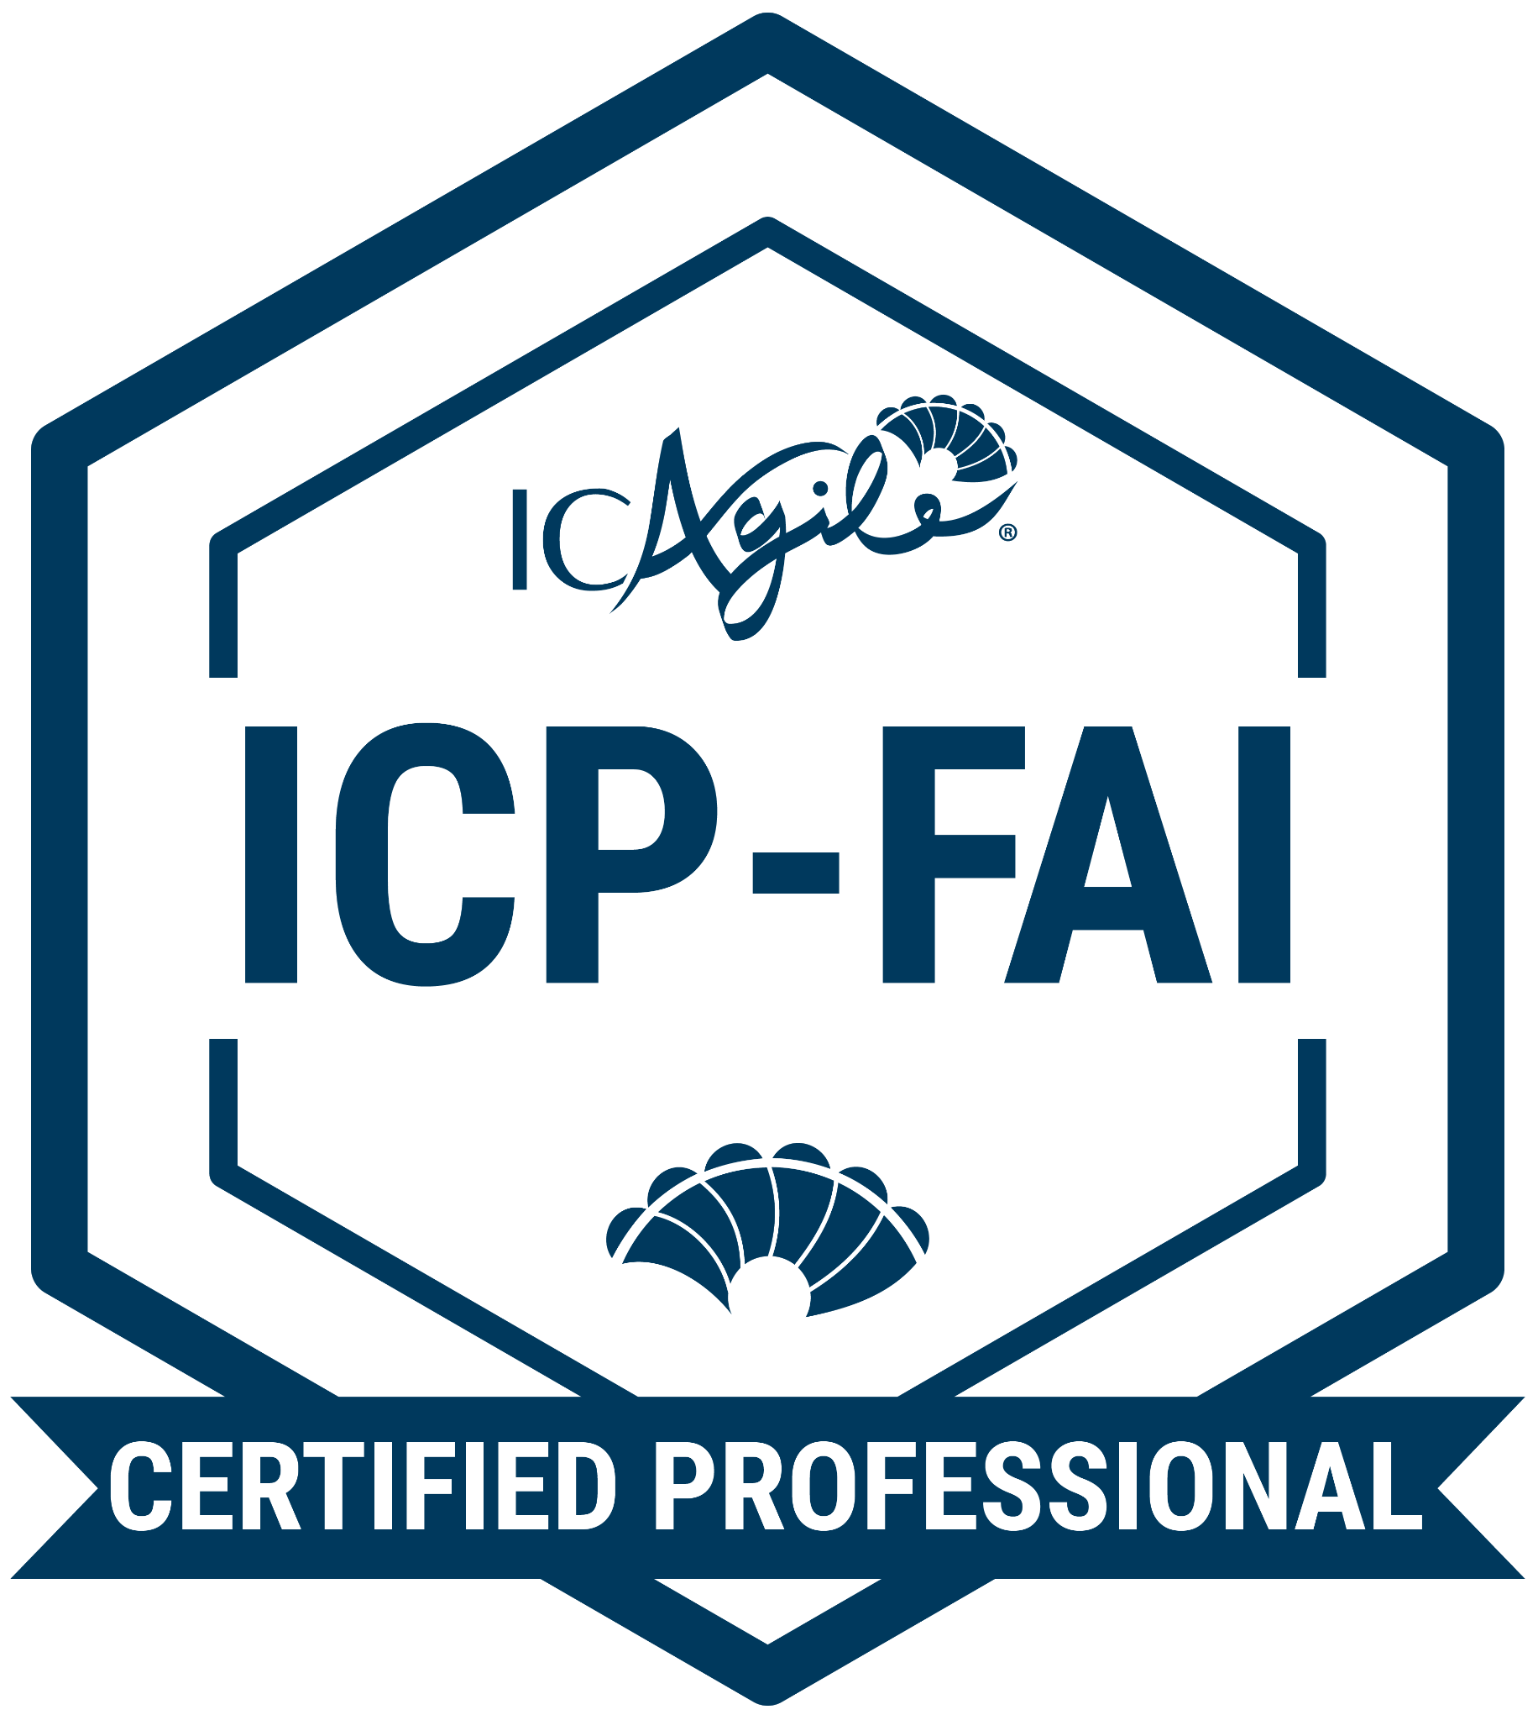
Foundations of AI
ABOUT THIS CERTIFICATION
FEATURED LEARNING OUTCOMES
Learn how AI and machine learning can support your skills and creativity so that you can deliver work more efficiently. Understand the history and evolving state of AI, develop better prompt engineering techniques, and realize the strength of AI paired with your business strategies.
The history and evolution of AI and machine learning
Prompt engineering
Ethical challenges in the use of AI
Agile behaviors and AI
Go Back to Learning Programs

Slide 37
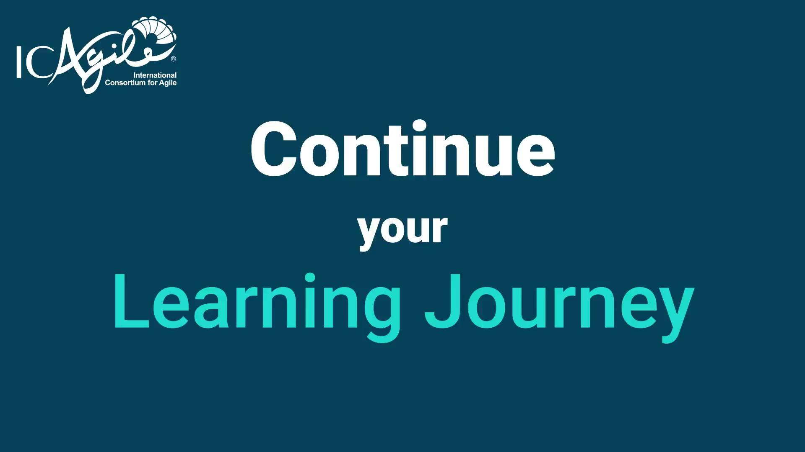
Notes:
End-of-Class Video

